Slide 1



Slide 2
t-SNE

Slide 3
t-distributed Stochastic
Neighbor Embedding

Slide 5
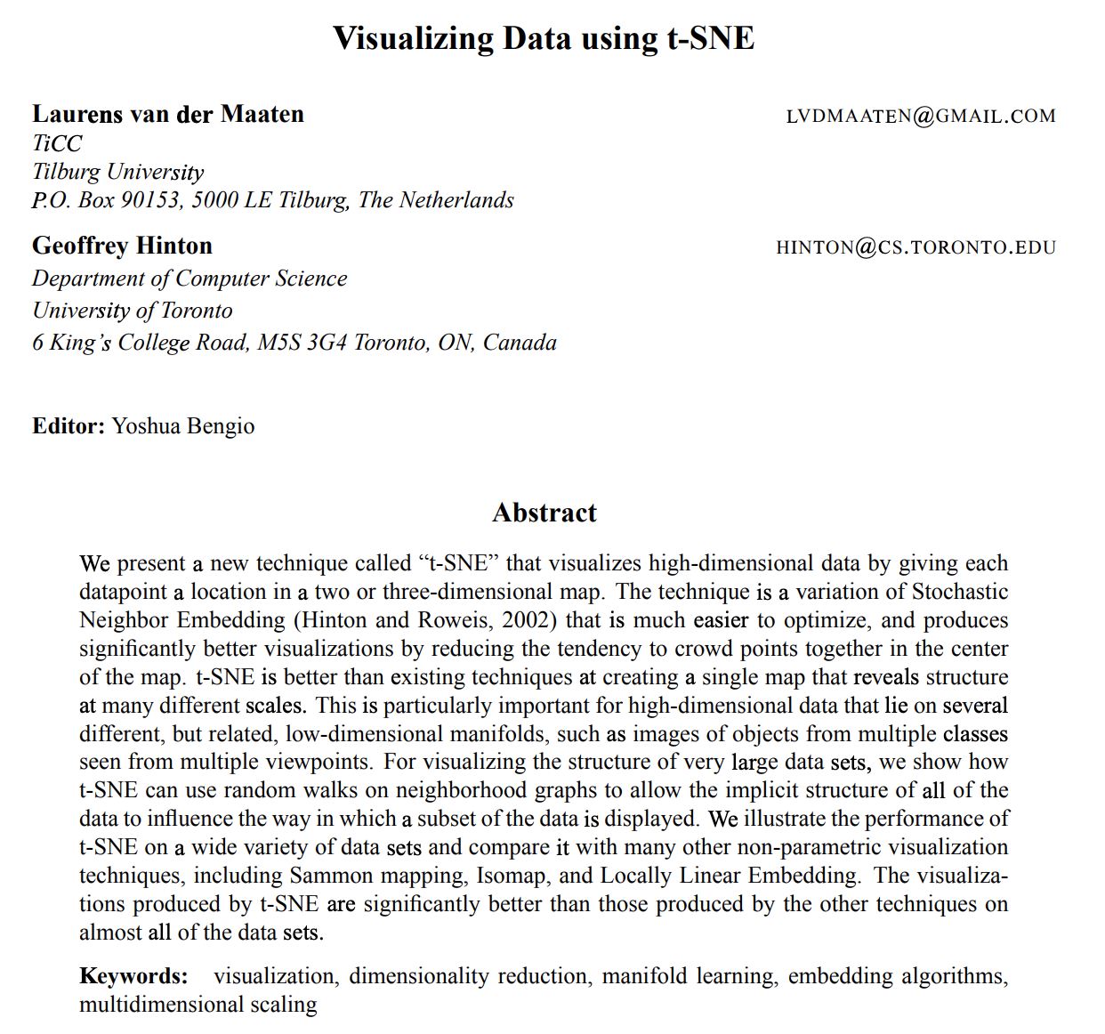

t-SNE
references
tSNE is a technique of dimensionality reduction algorithm to visualize high-dimensional data.
Laurens van der Maaten in 2008

Slide 6
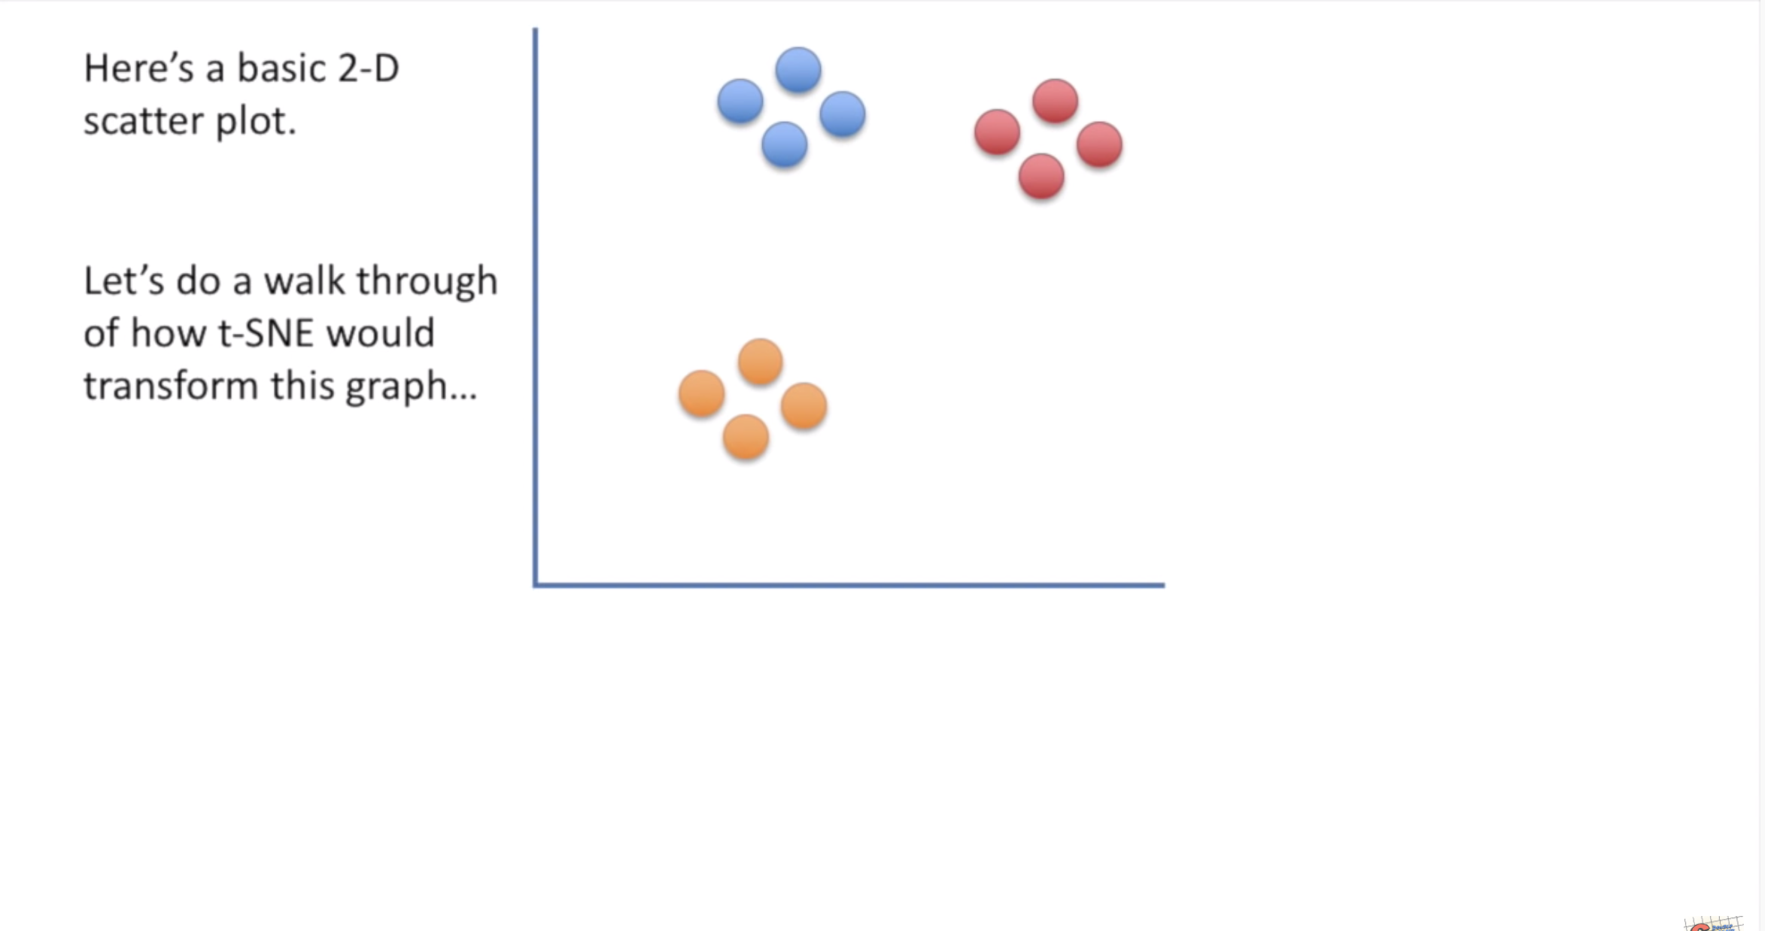
t-SNE
theory

Slide 7
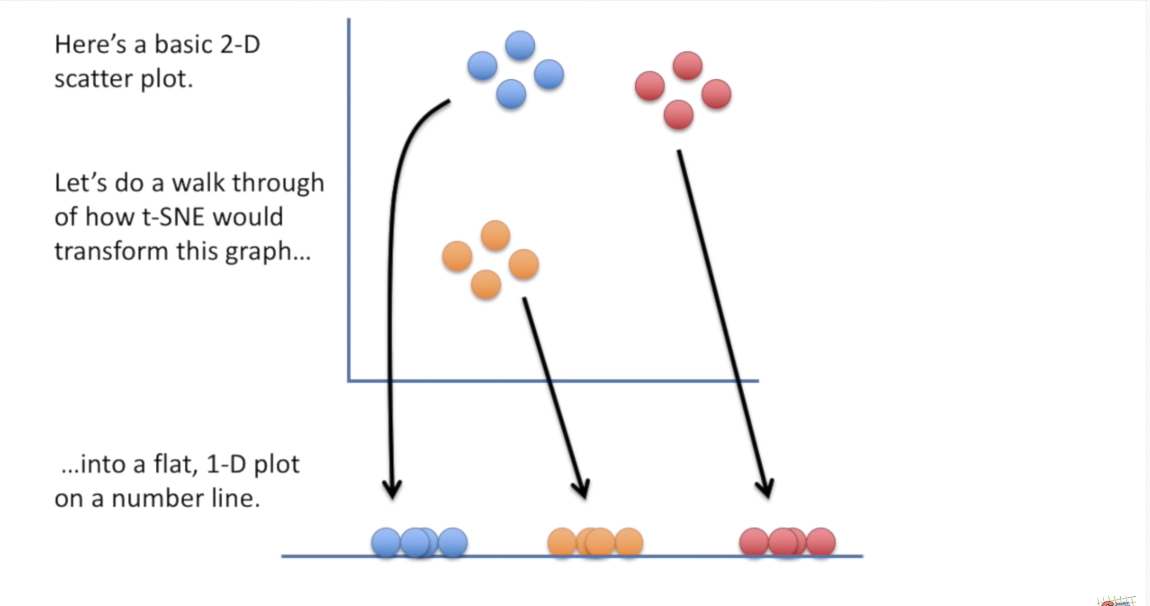
t-SNE
theory

Slide 8
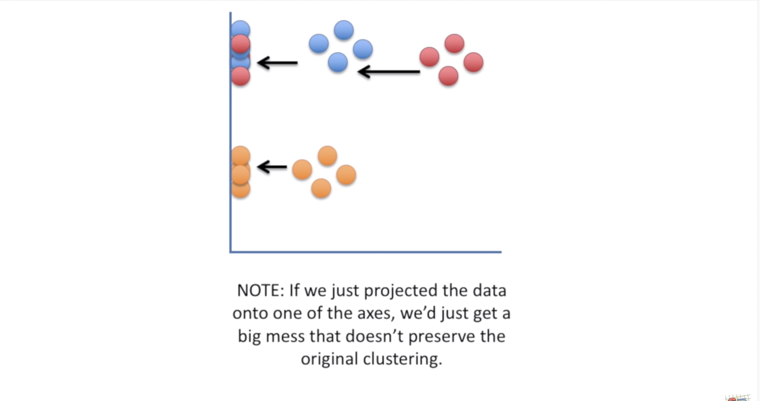
t-SNE
theory

Slide 9
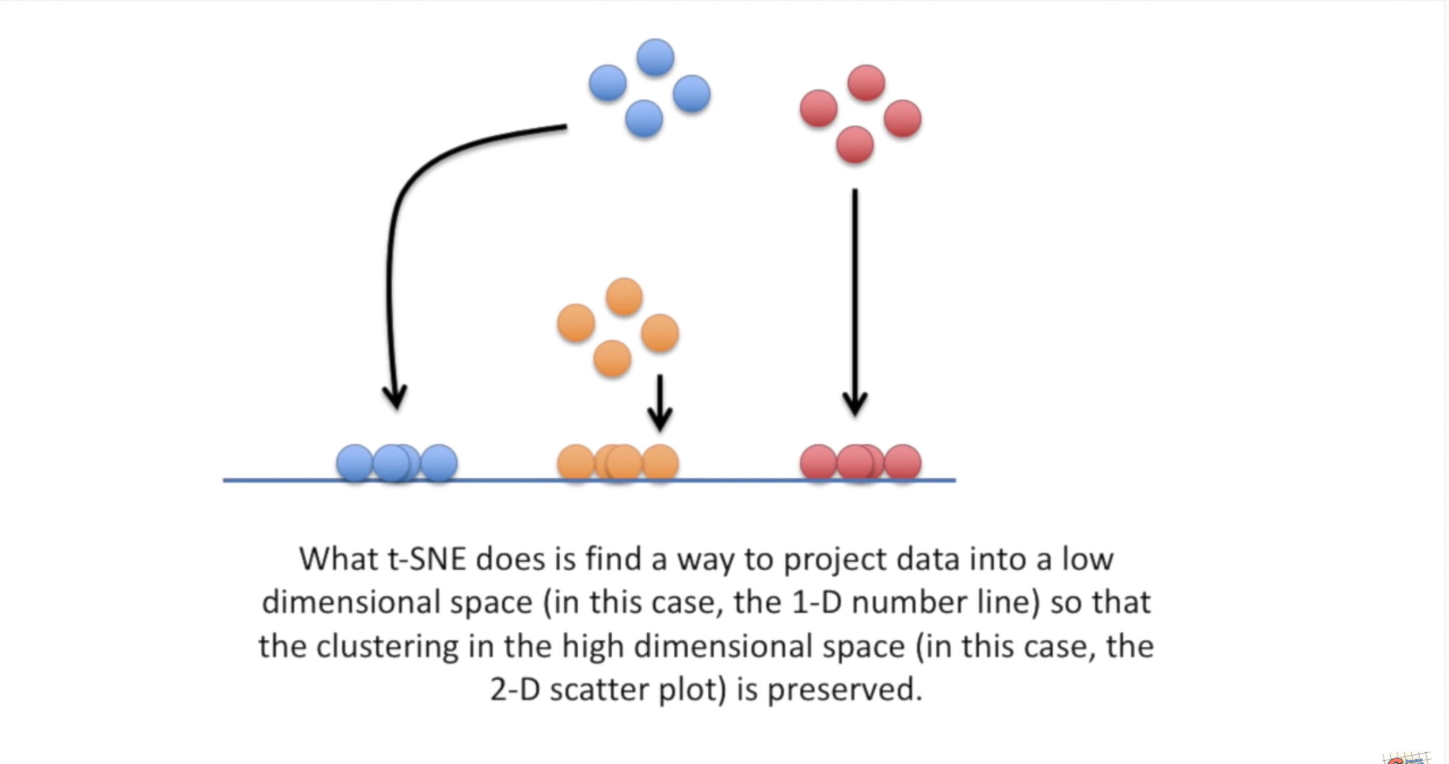
t-SNE
theory

Slide 10
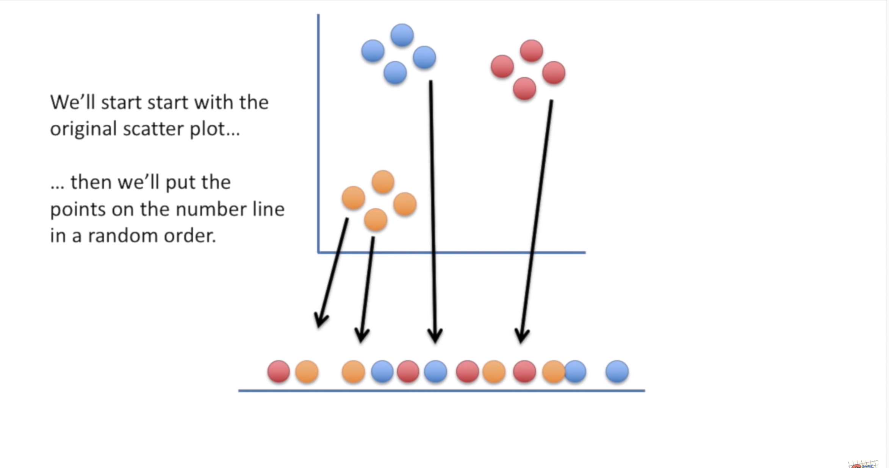
t-SNE
theory

Slide 11
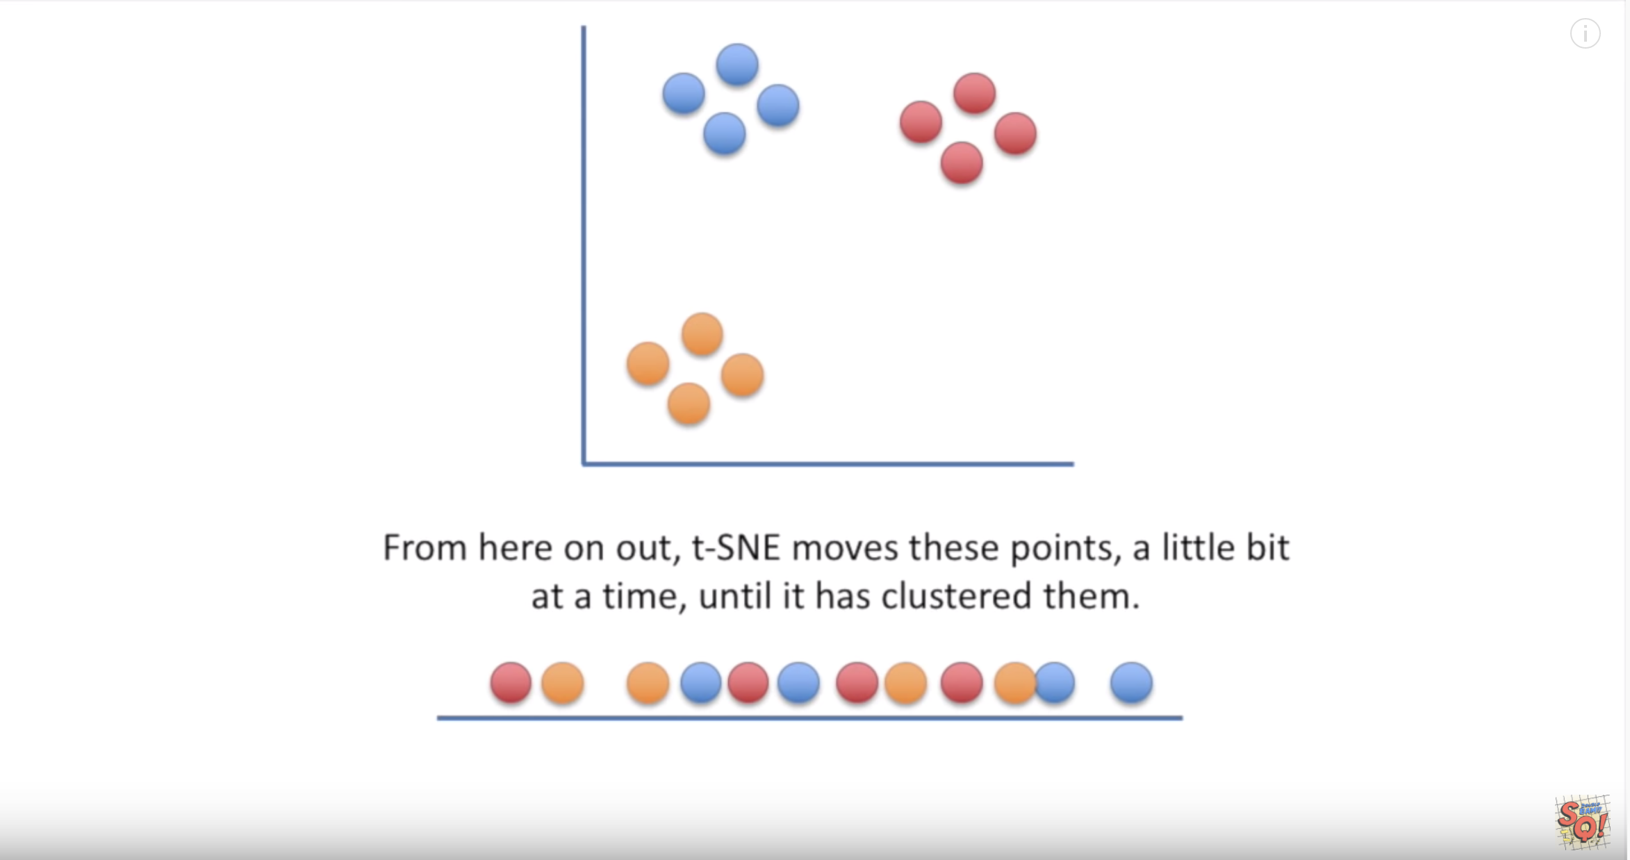
t-SNE
theory

Slide 12
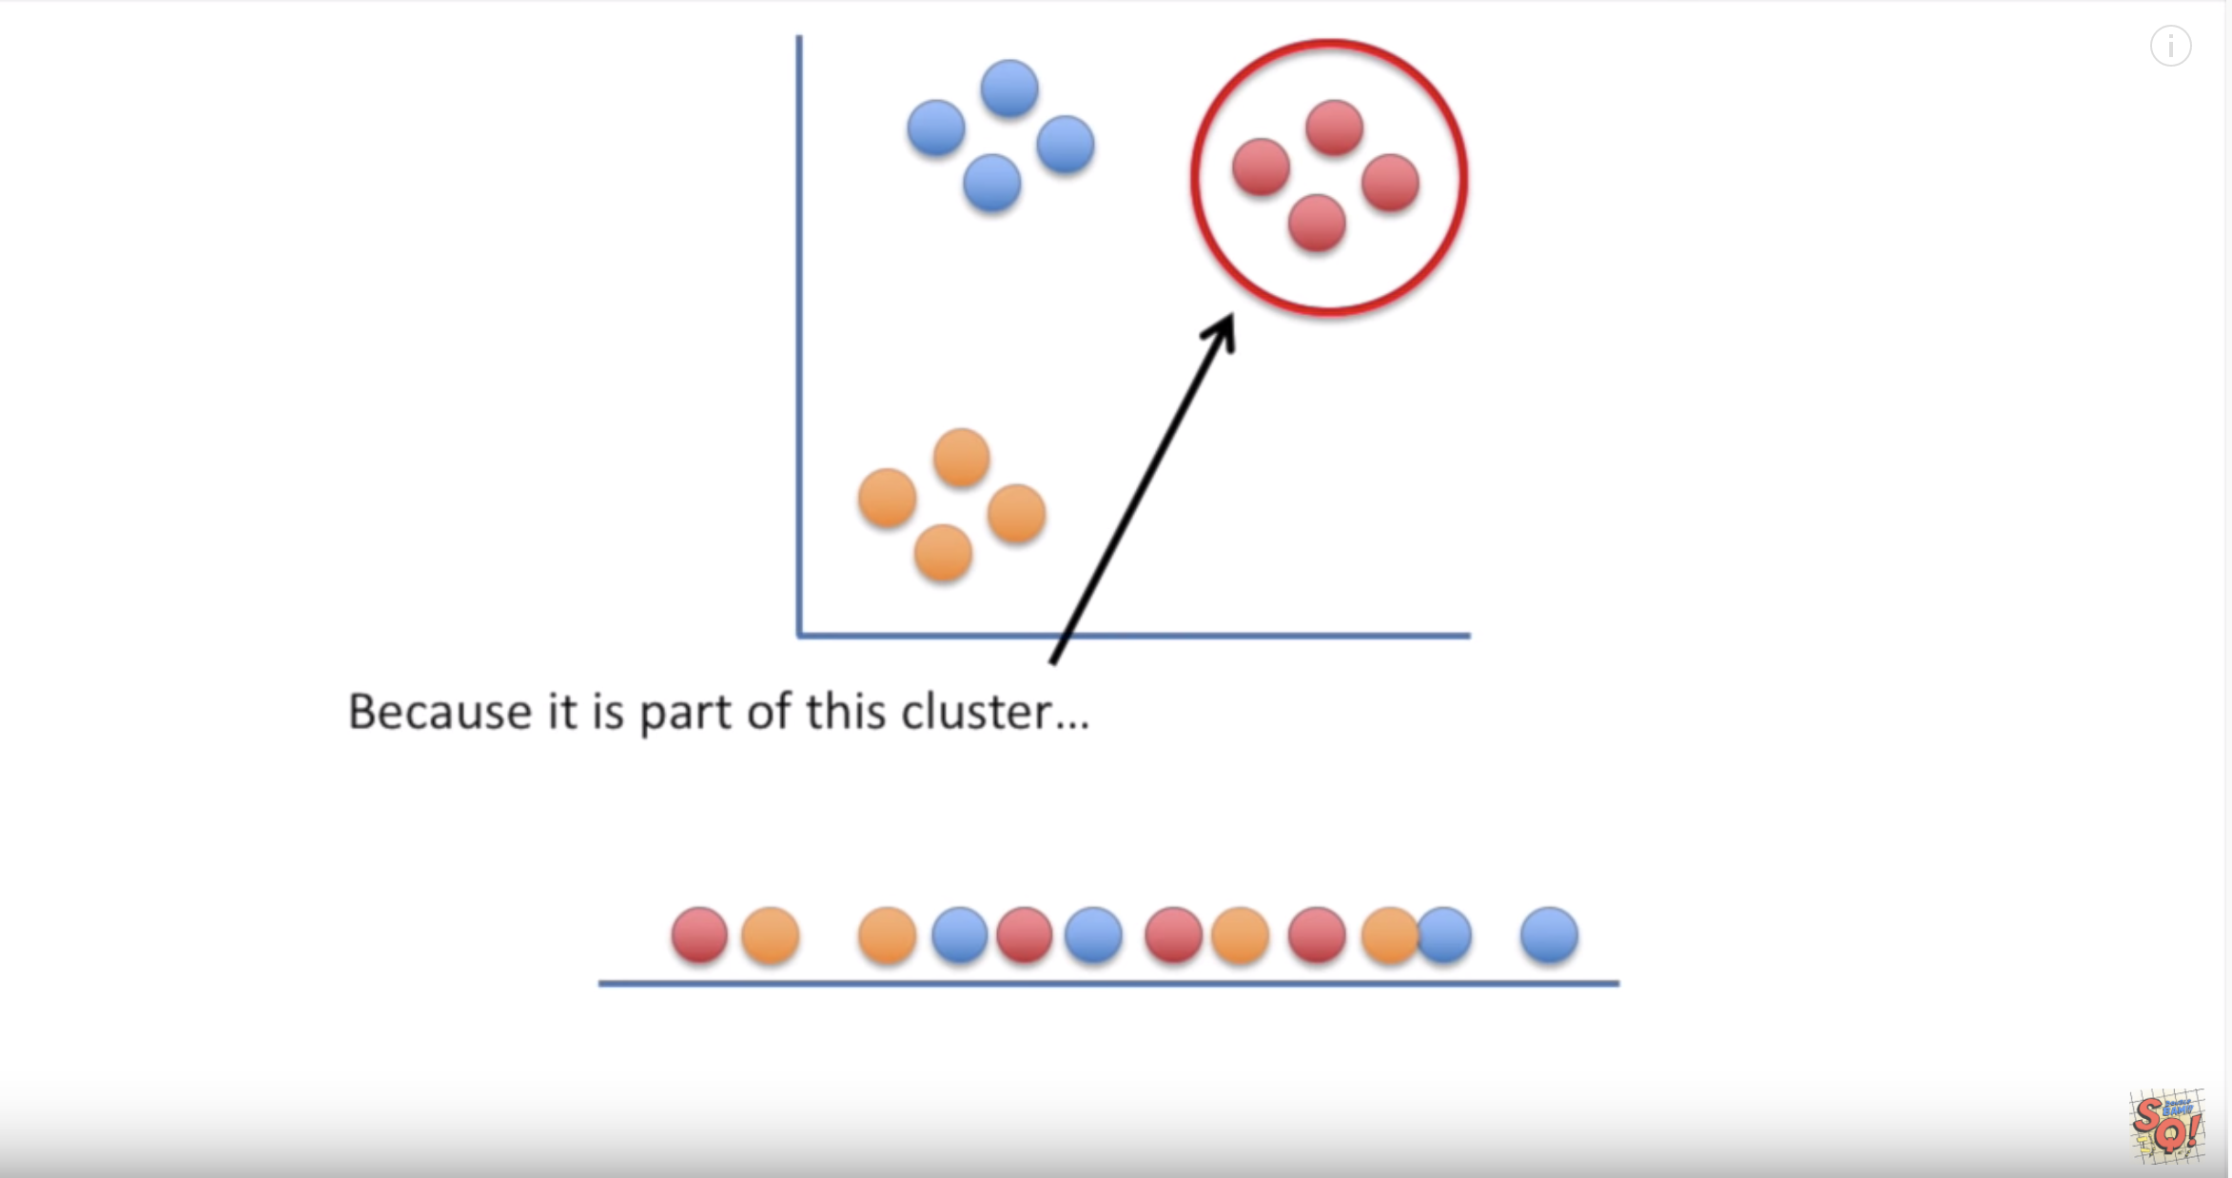
t-SNE
theory

Slide 13
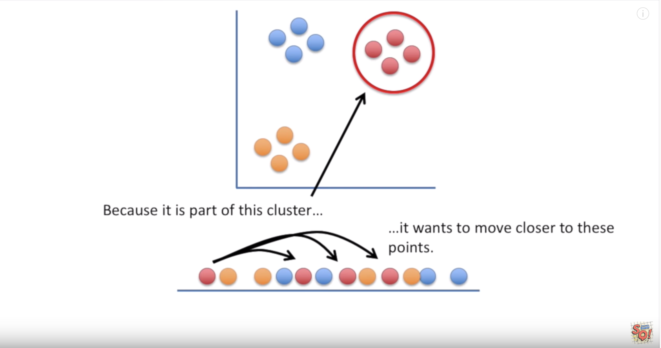
t-SNE
theory

Slide 14
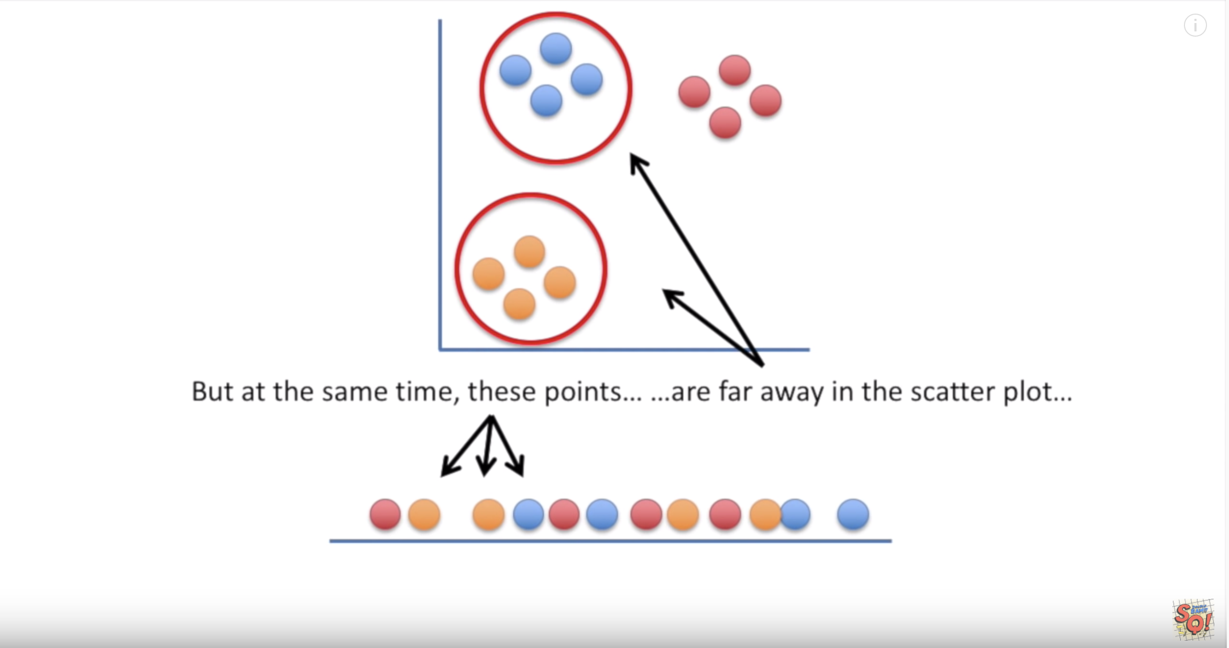
t-SNE
theory

Slide 15
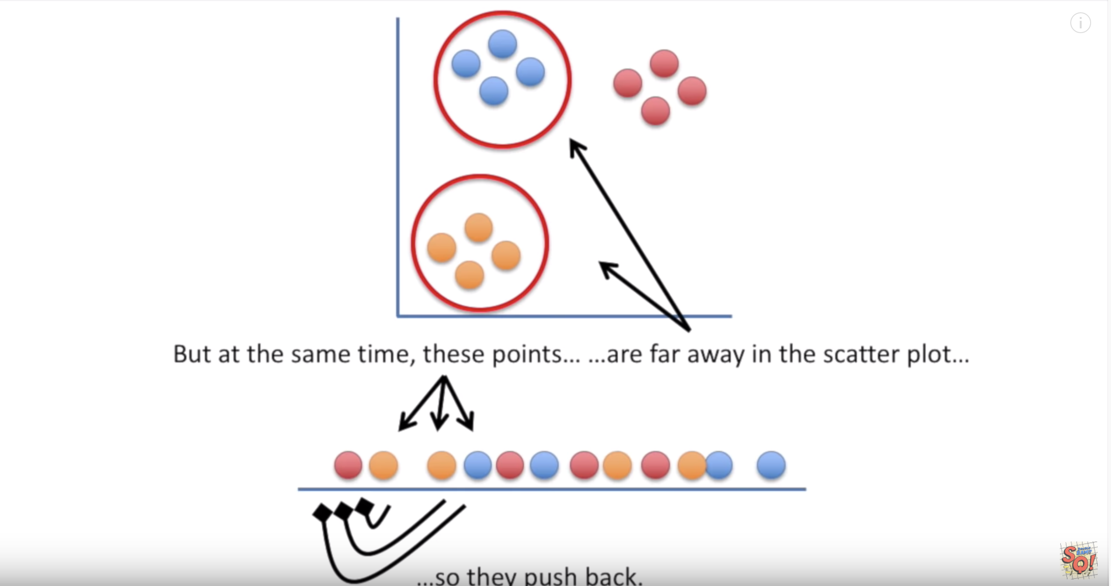
t-SNE
theory

Slide 16
t-SNE
theory

Slide 17
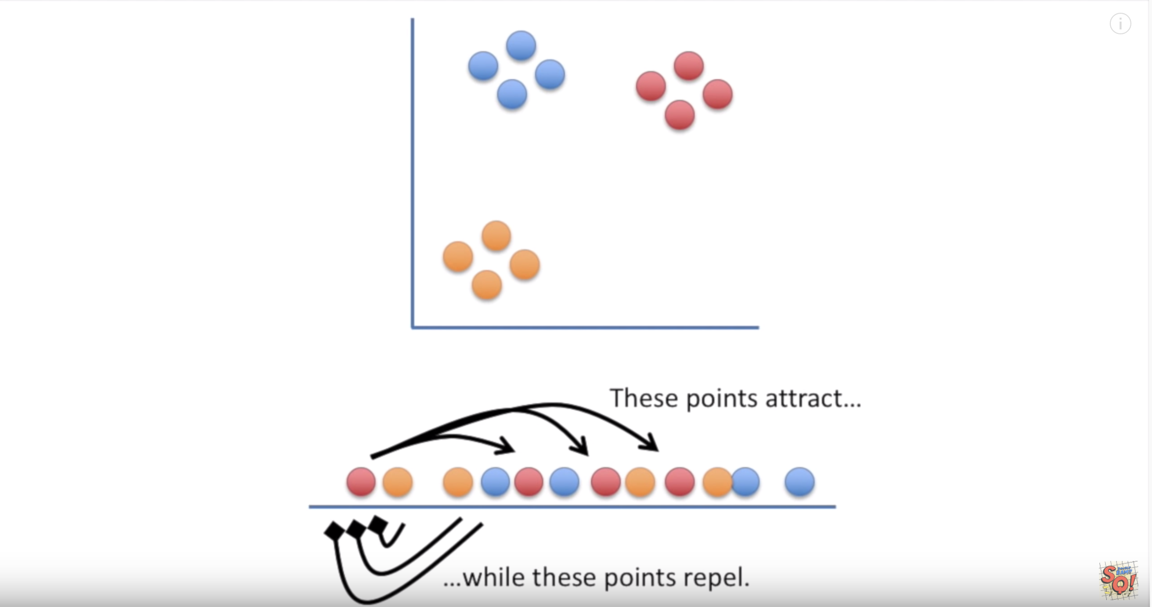

t-SNE
theory

Slide 18
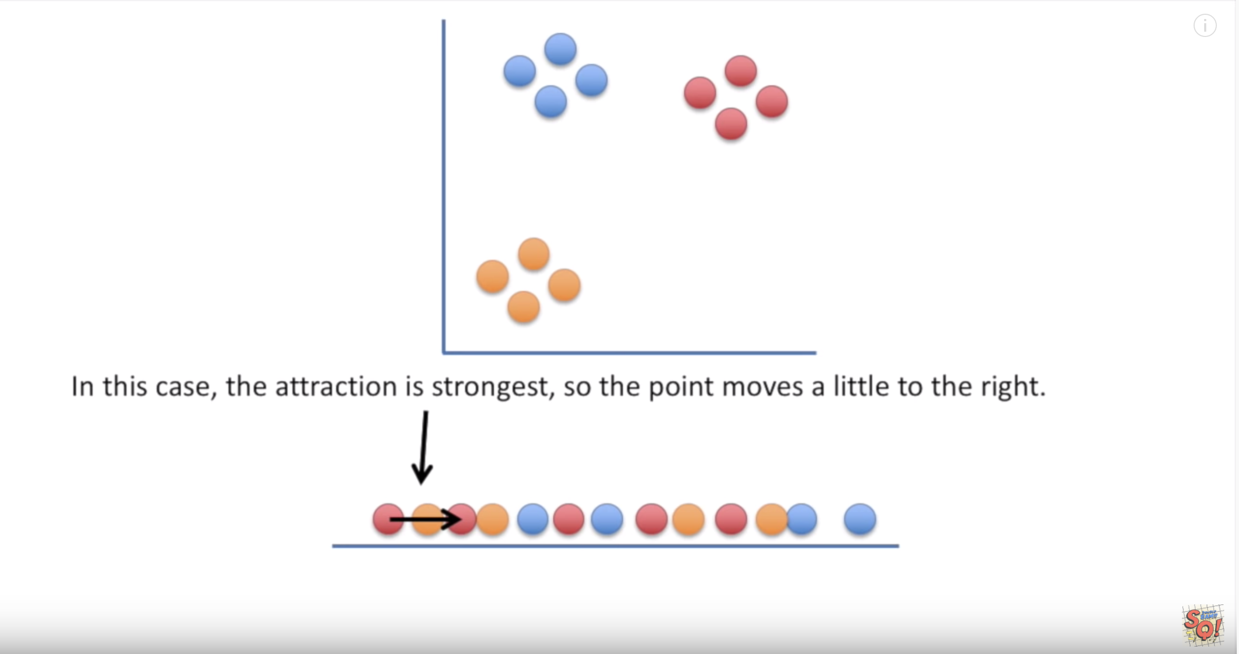
t-SNE
theory

Slide 19
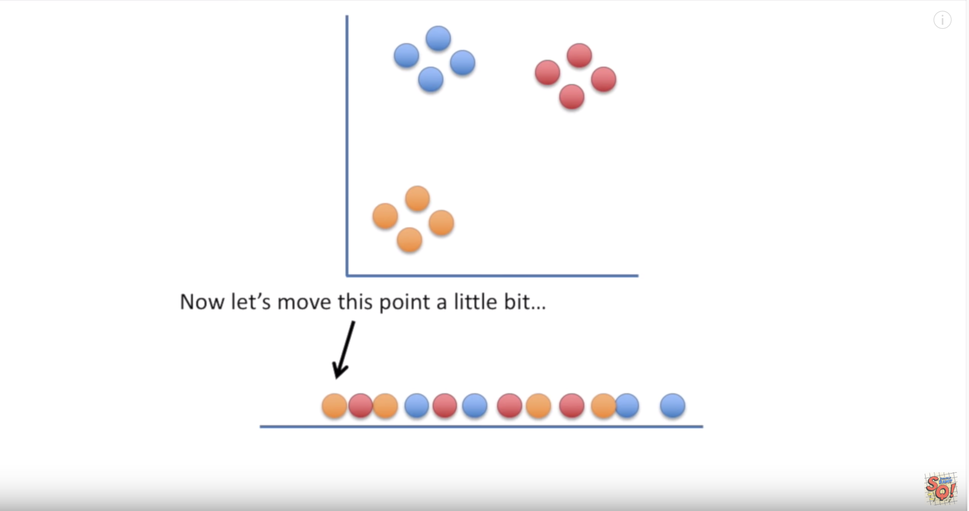
t-SNE
theory

Slide 20
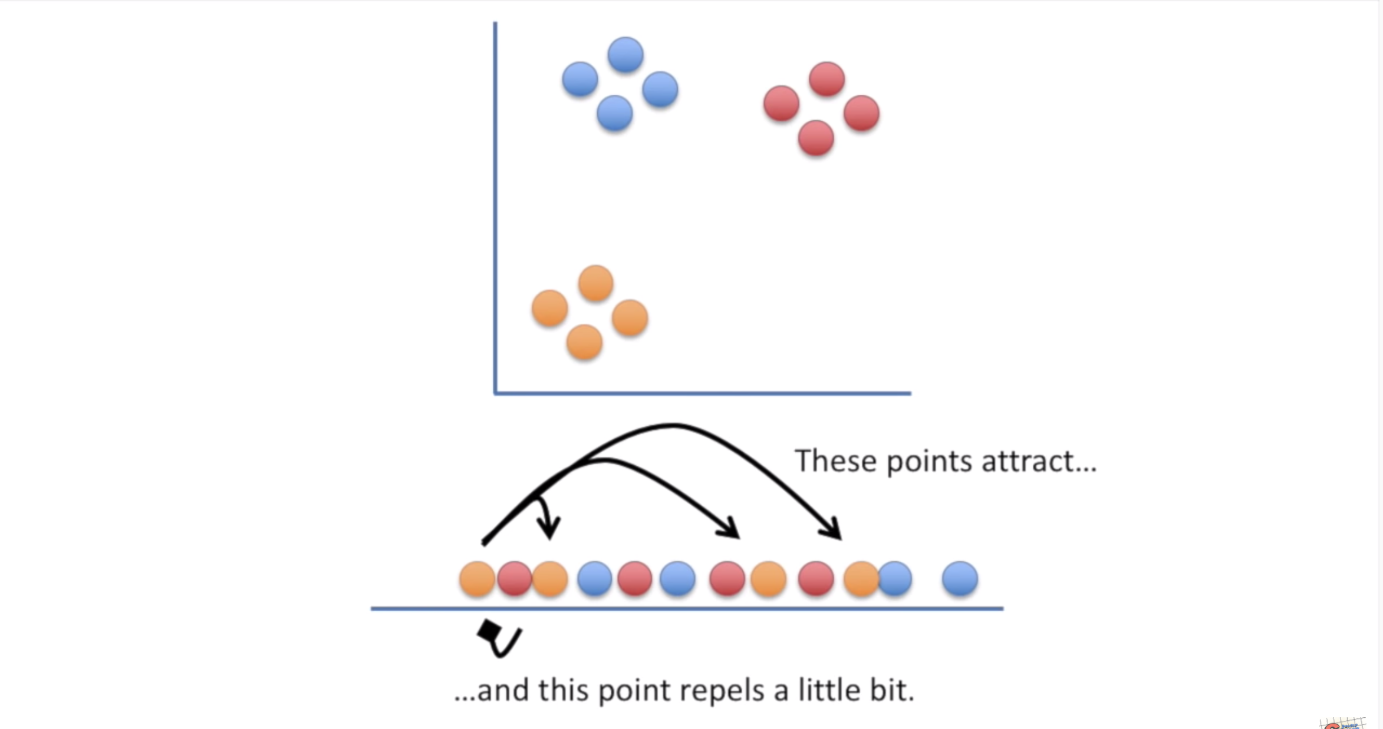
t-SNE
theory

Slide 21
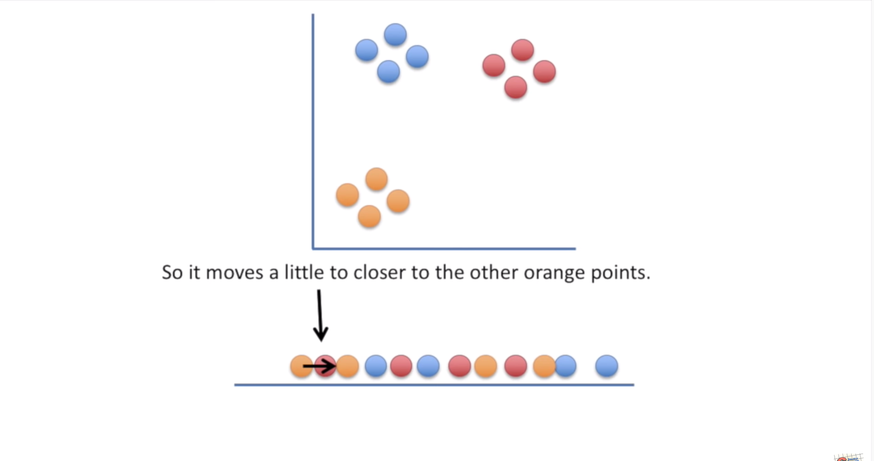
t-SNE
theory

Slide 22
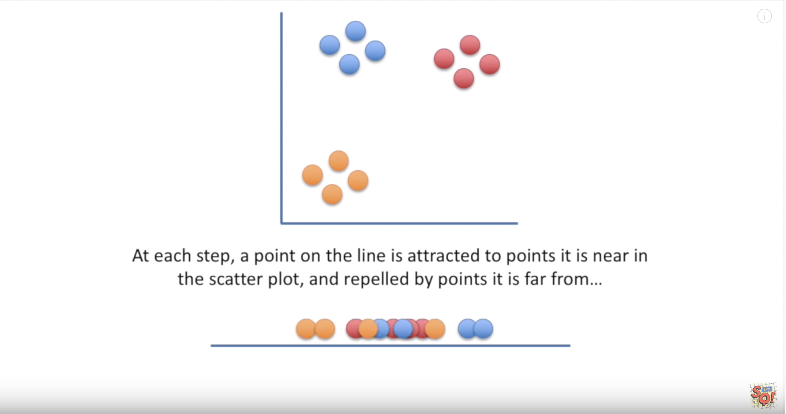
t-SNE
theory

Slide 23
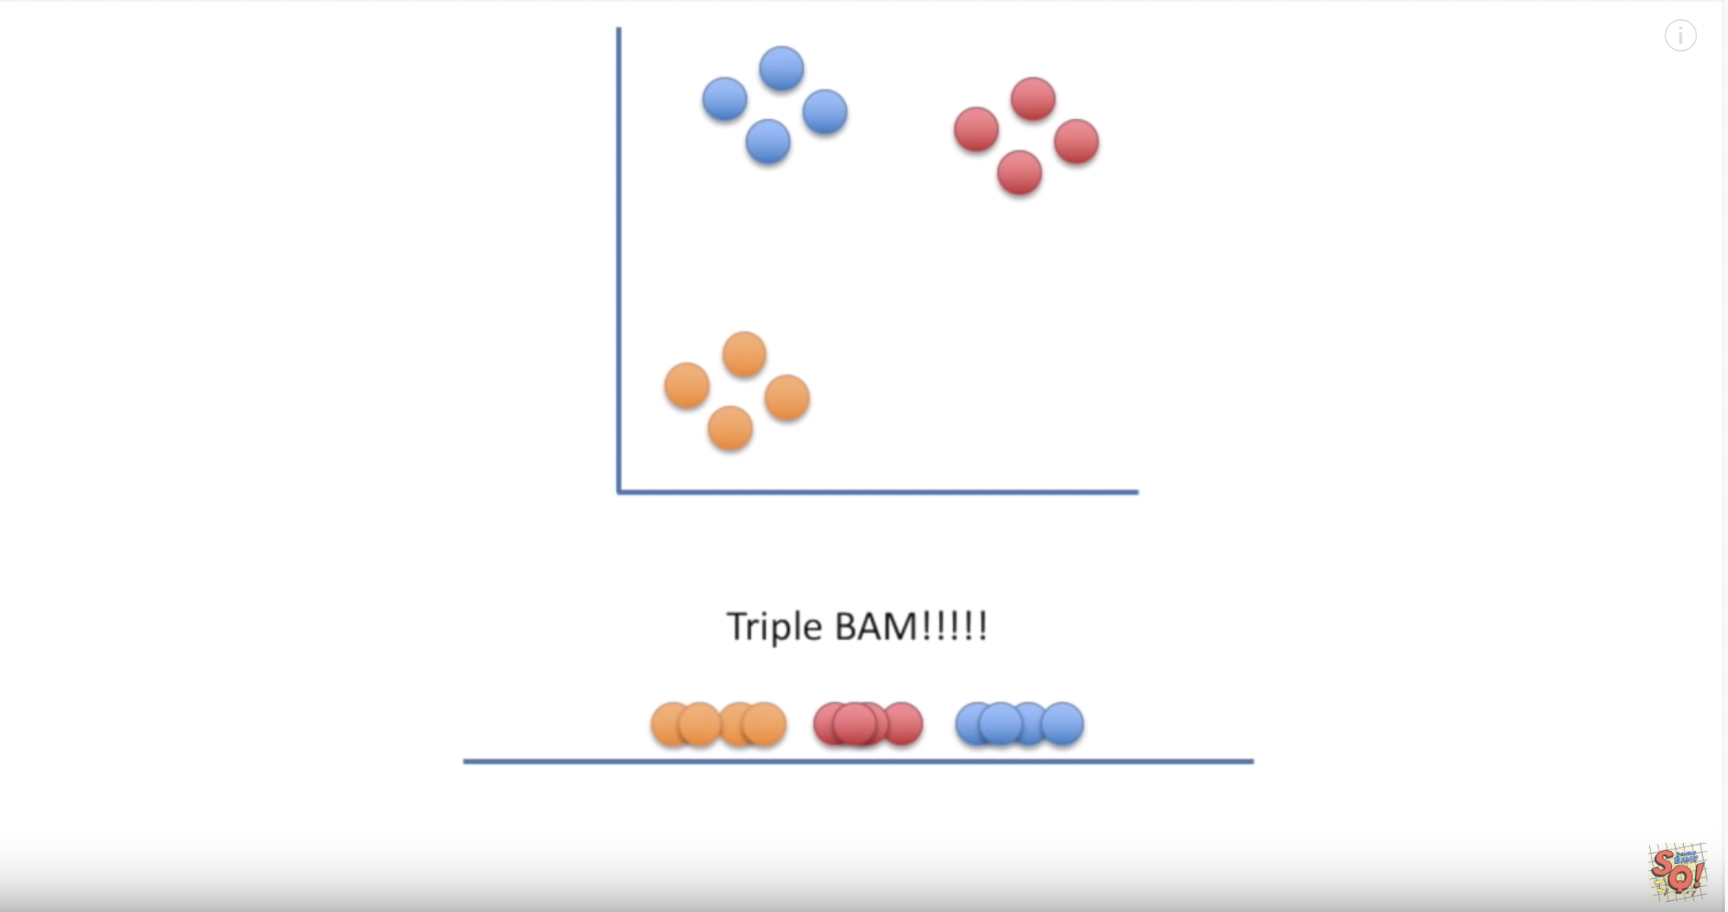
t-SNE
theory

Slide 24
t-SNE
theory

Slide 25
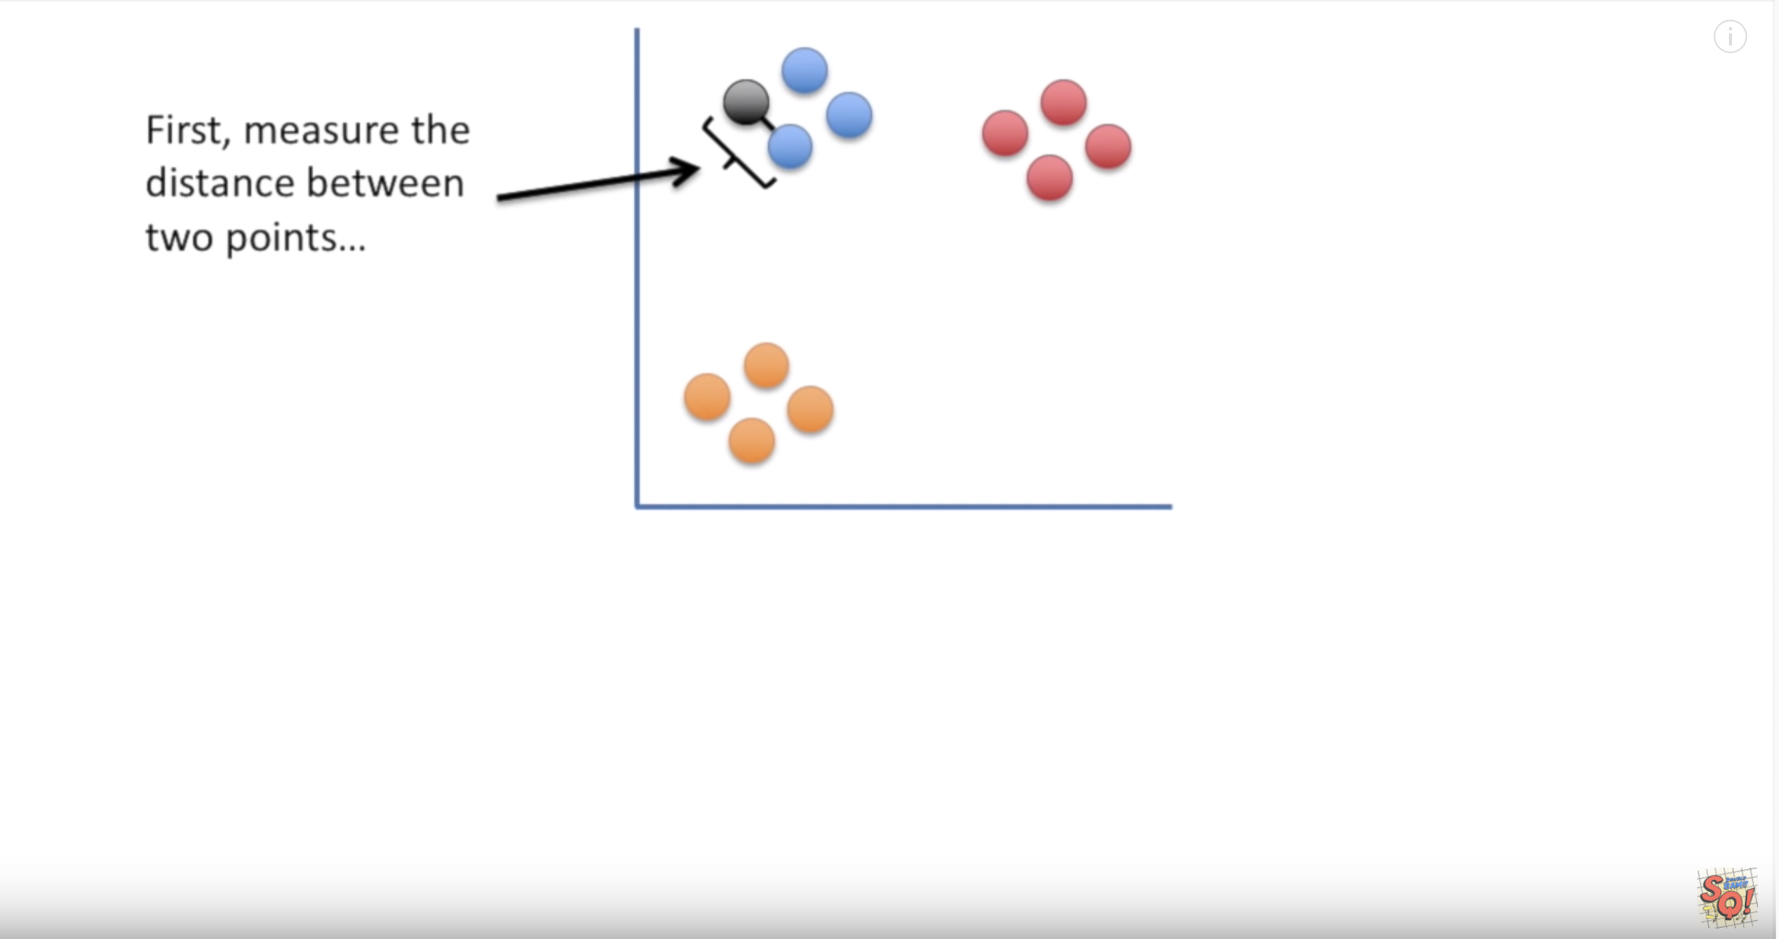
t-SNE
theory

Slide 26
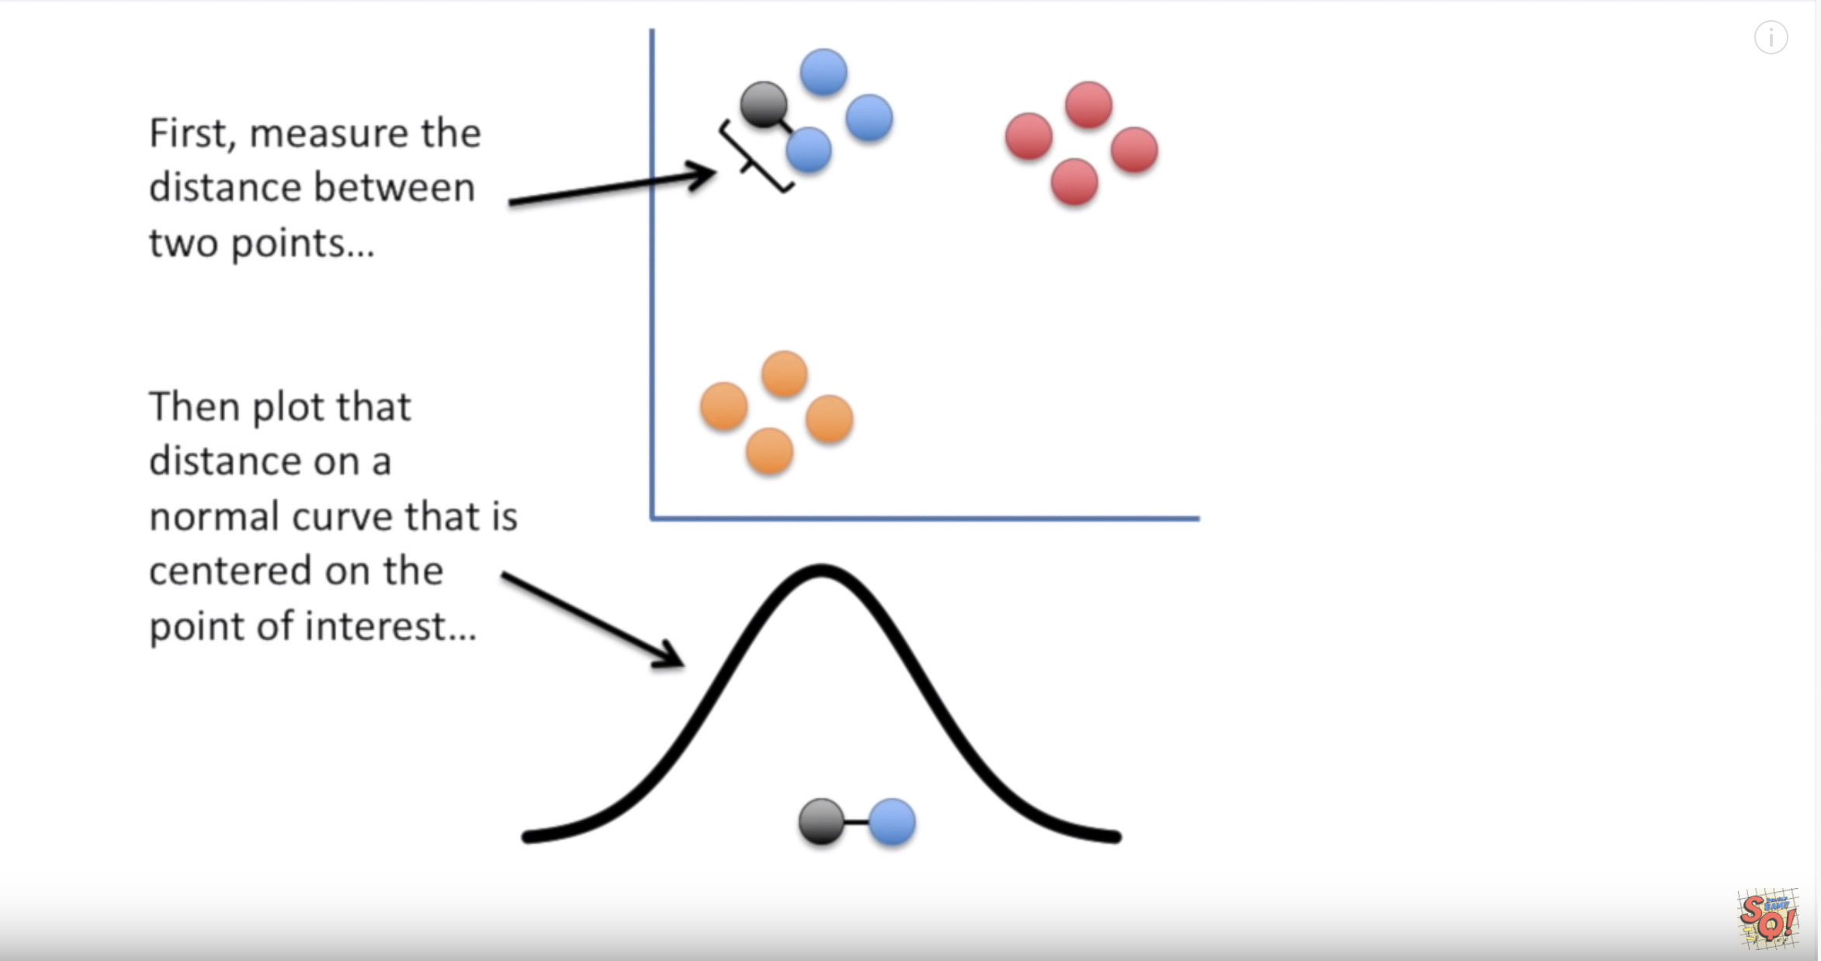
t-SNE
theory

Slide 27
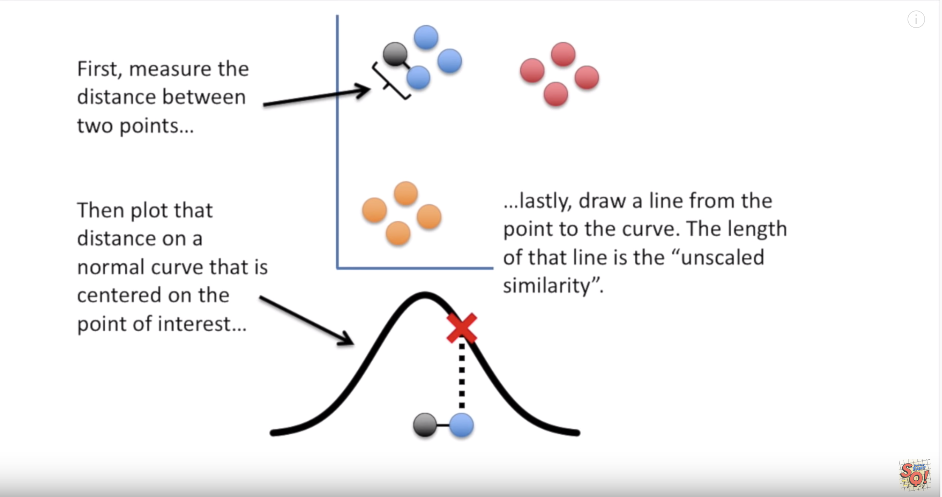
t-SNE
theory

Slide 28
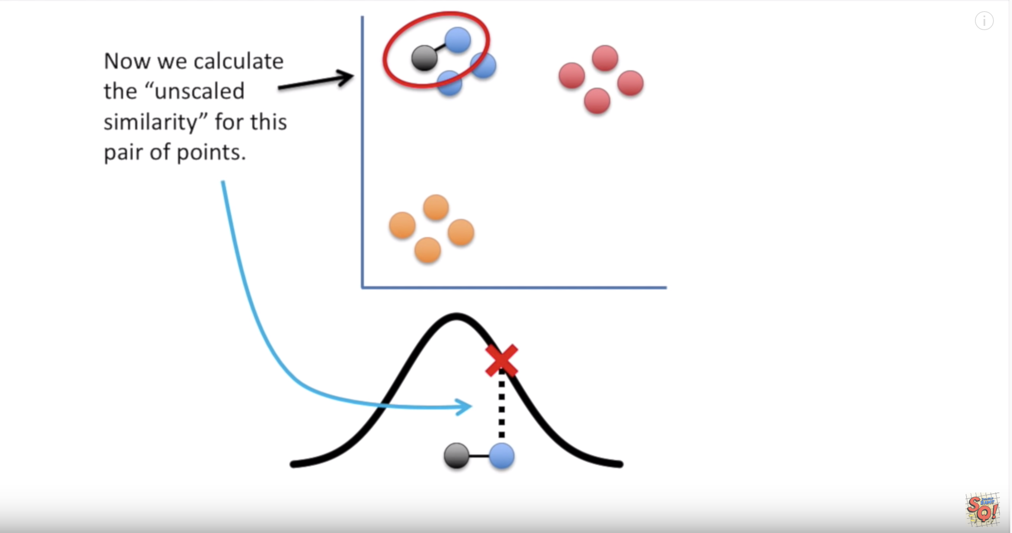
t-SNE
theory

Slide 29
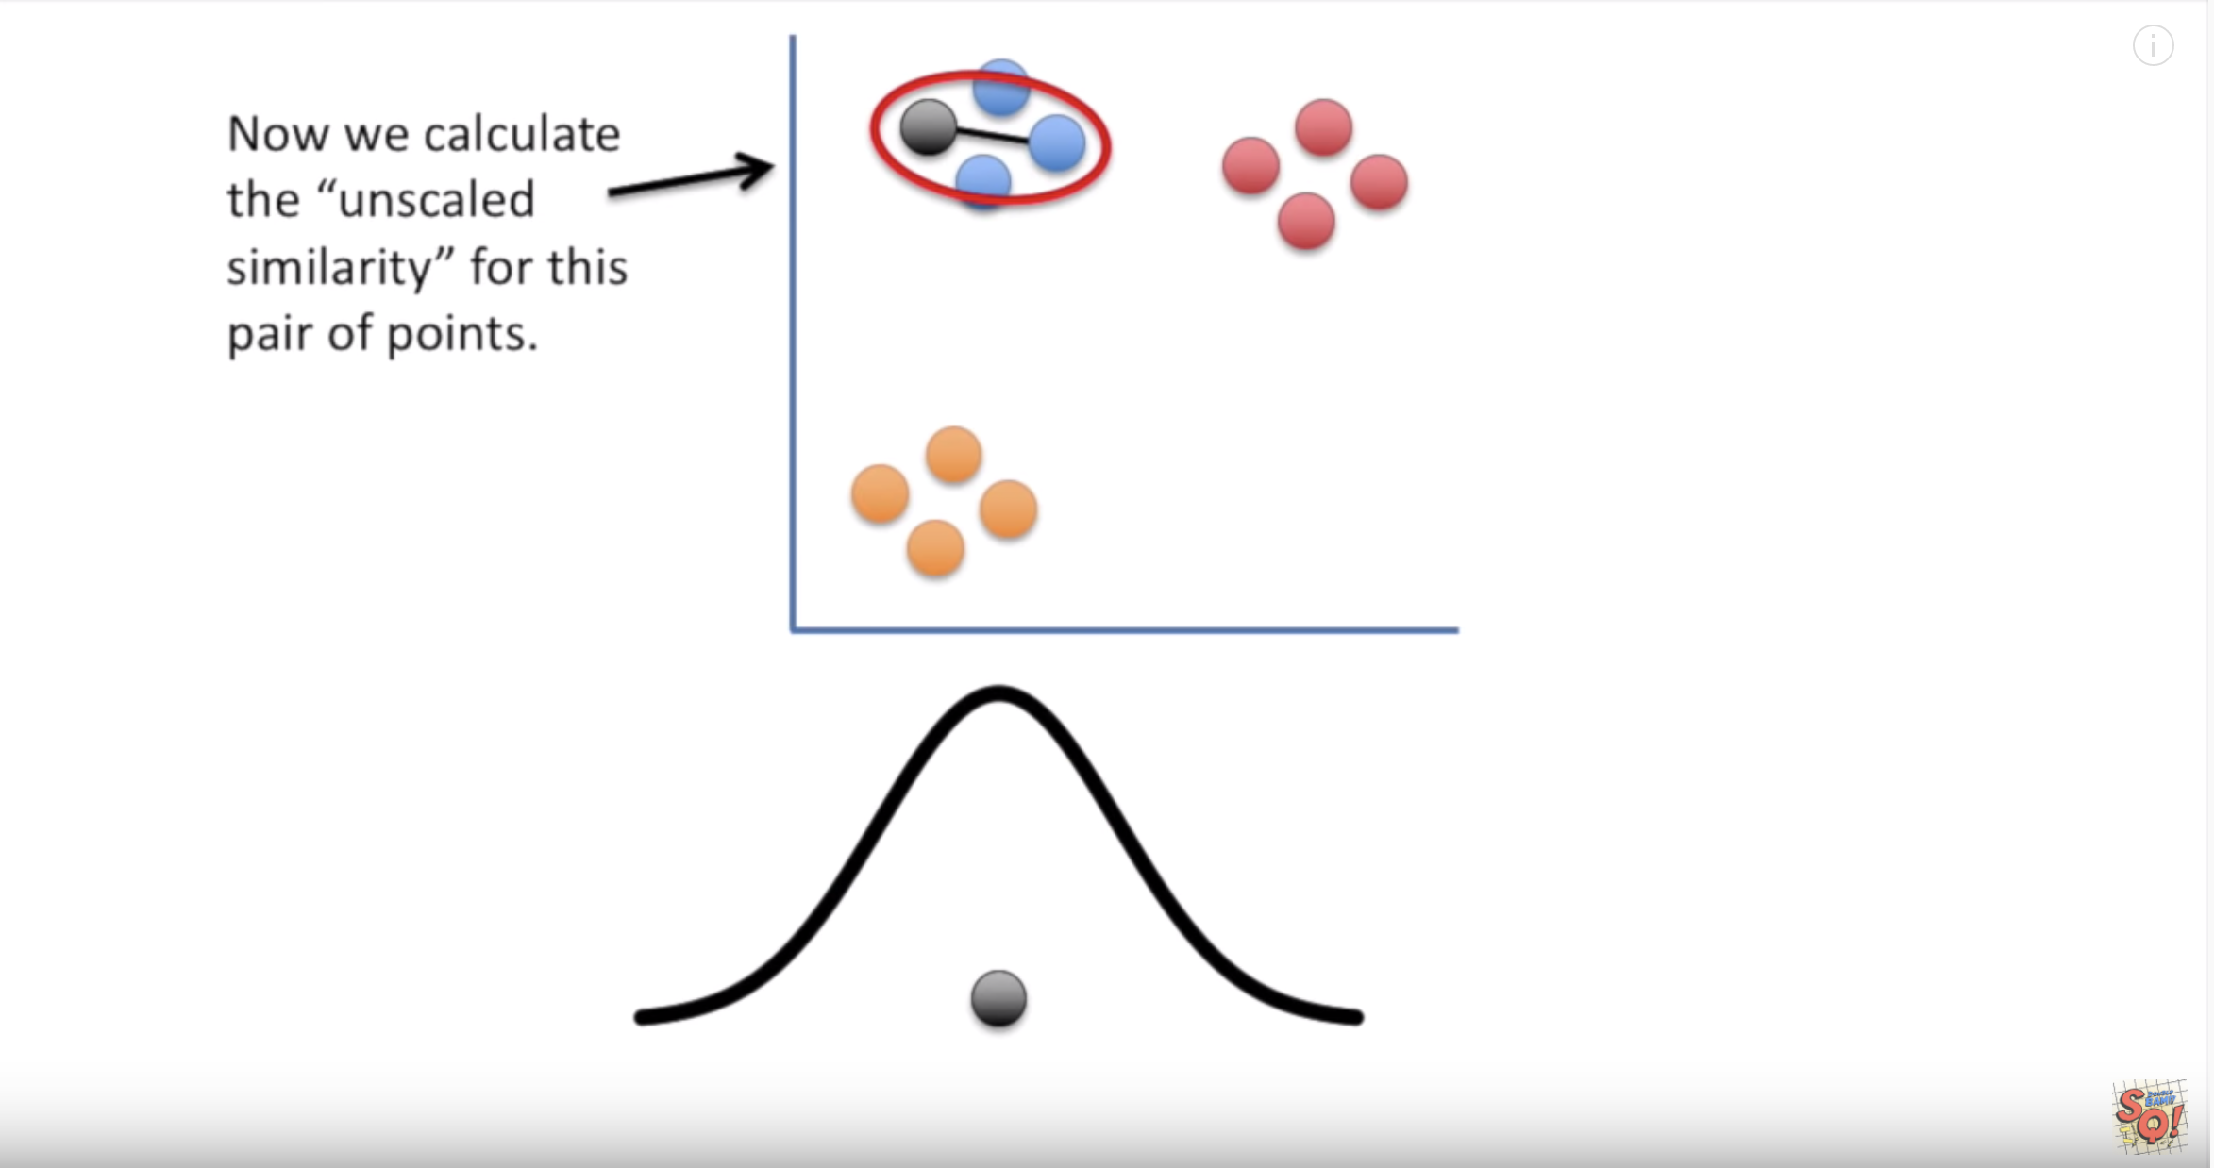
t-SNE
theory

Slide 30
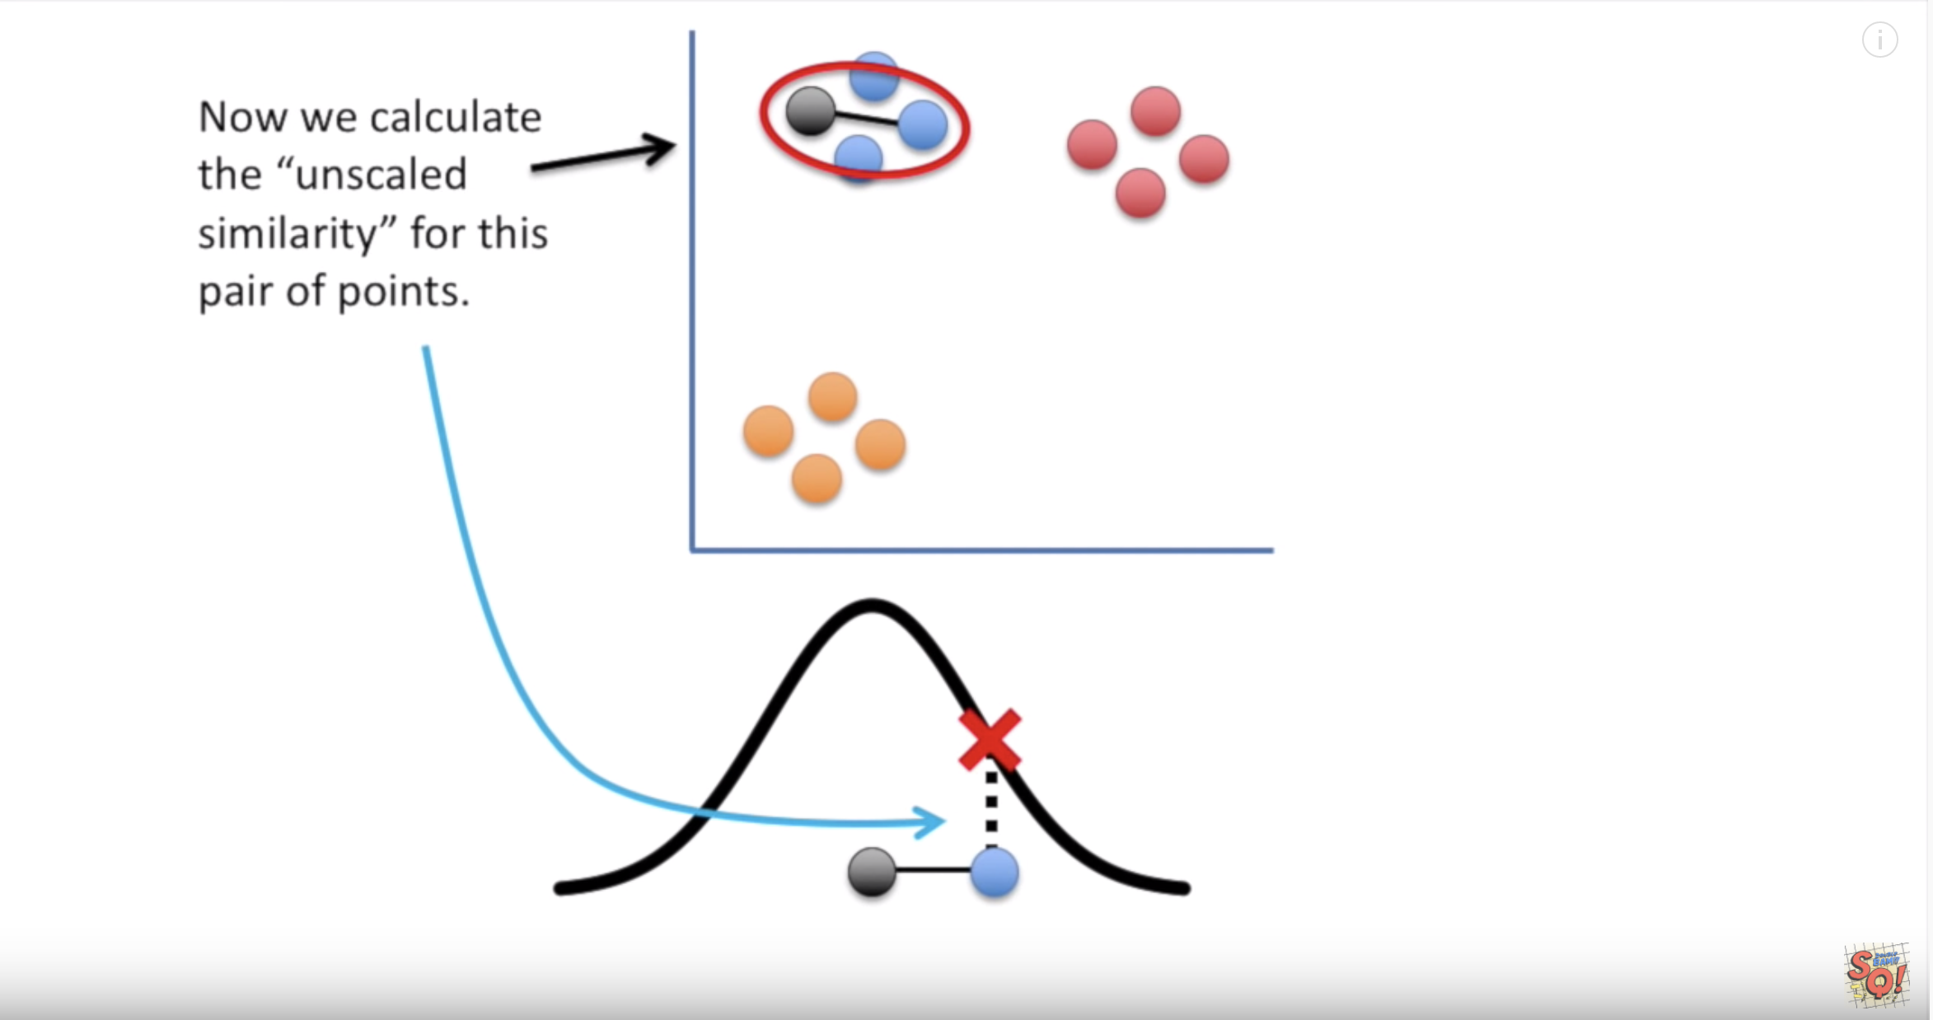
t-SNE
theory

Slide 31
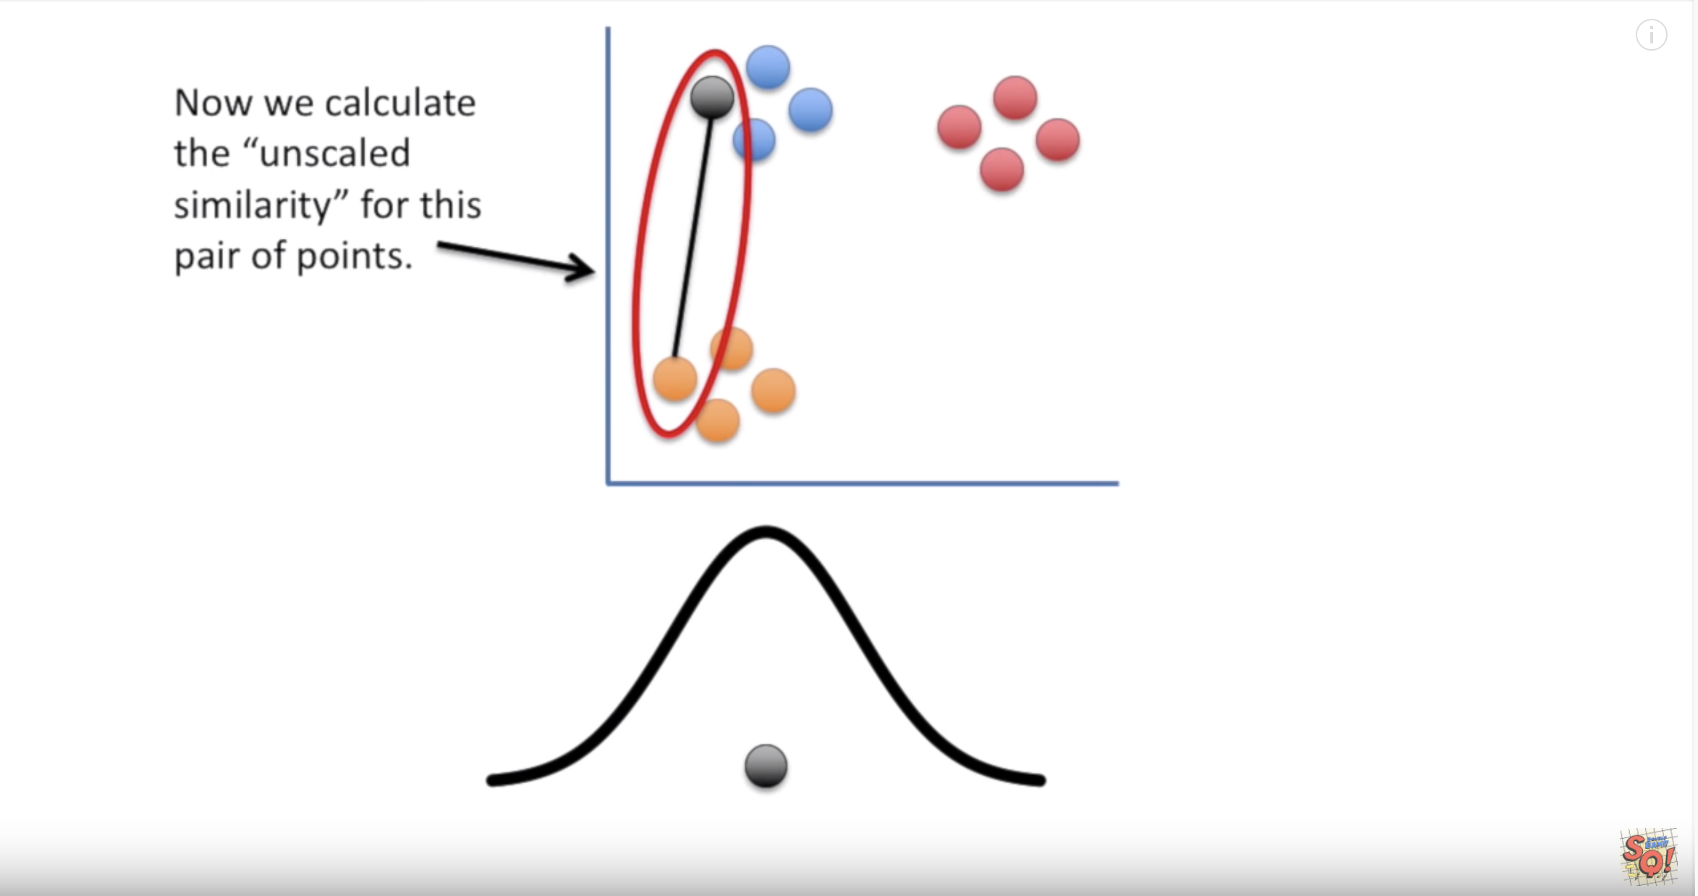
t-SNE
theory

Slide 32
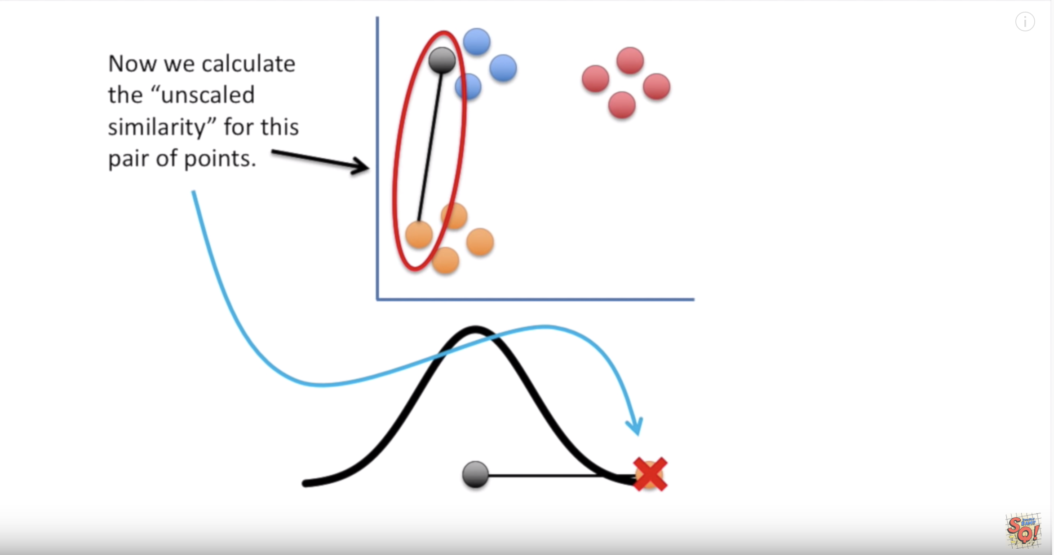
t-SNE
theory

Slide 33
t-SNE
theory

Slide 34
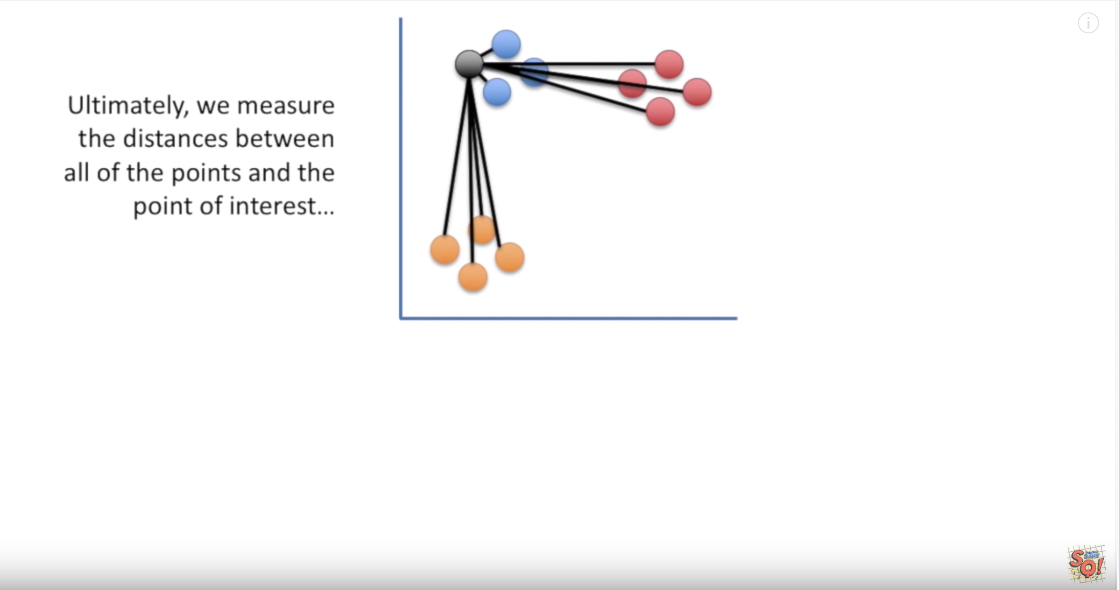
t-SNE
theory

Slide 35
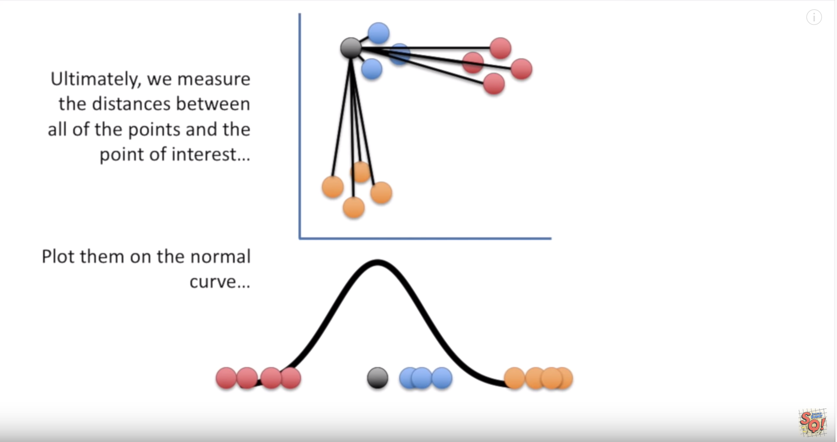
t-SNE
theory

Slide 36
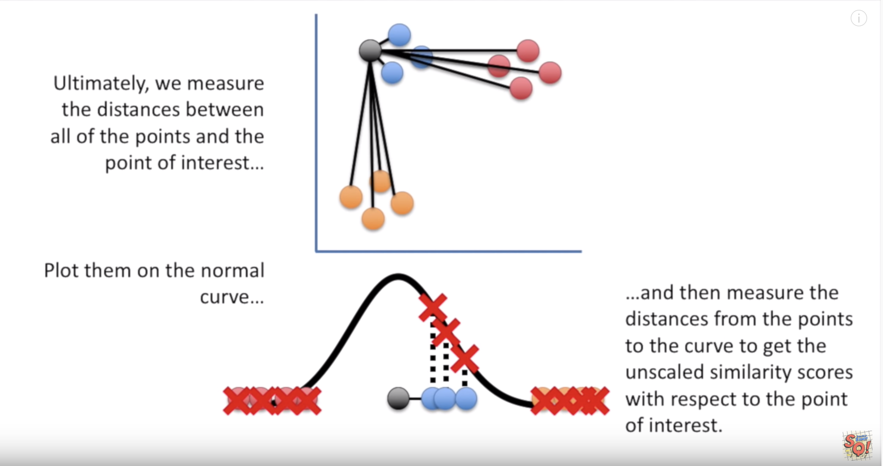
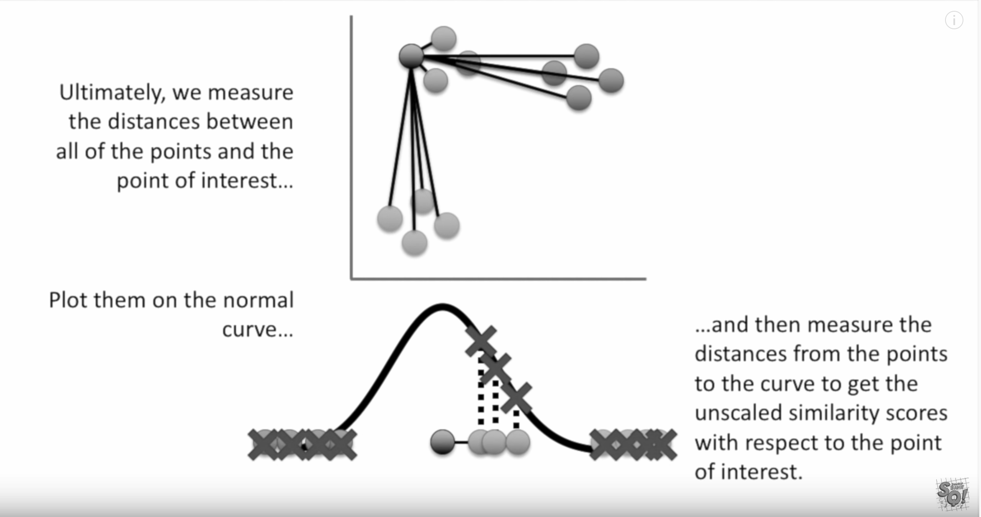
t-SNE
theory

Slide 37
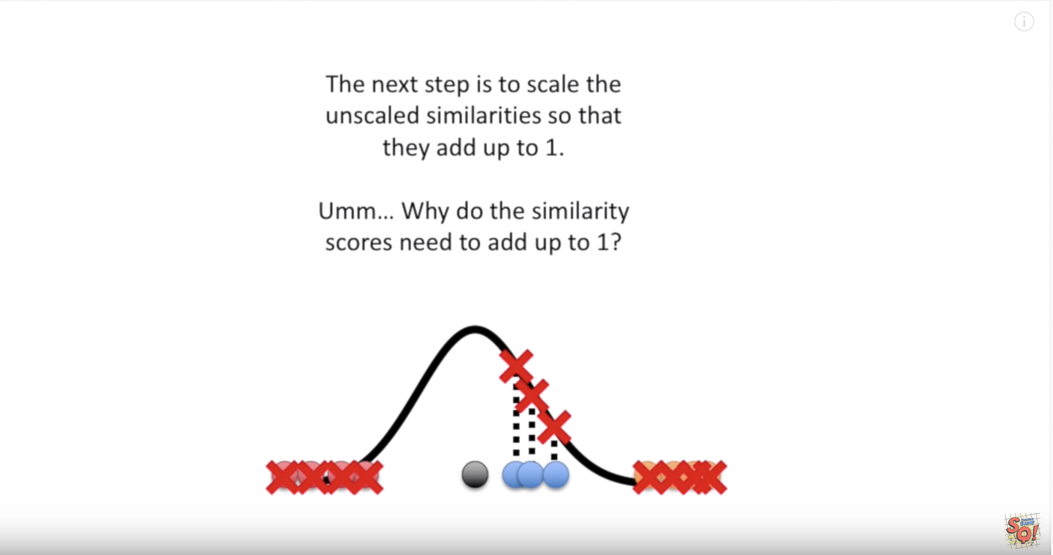
t-SNE
theory

Slide 38
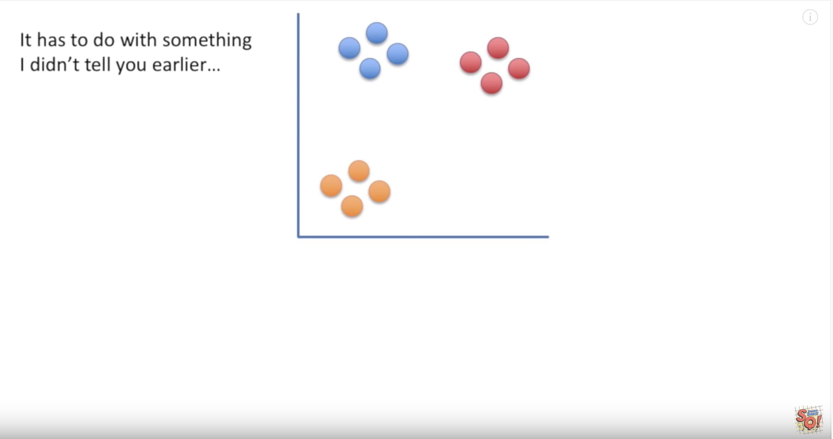
t-SNE
theory

Slide 39
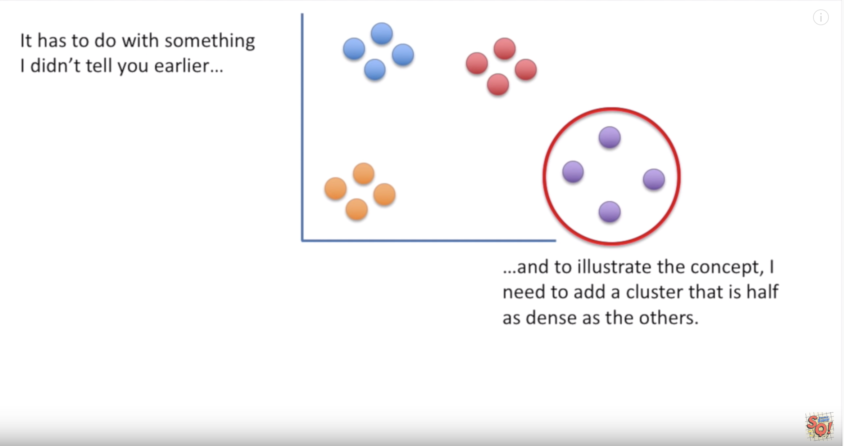
t-SNE
theory

Slide 40
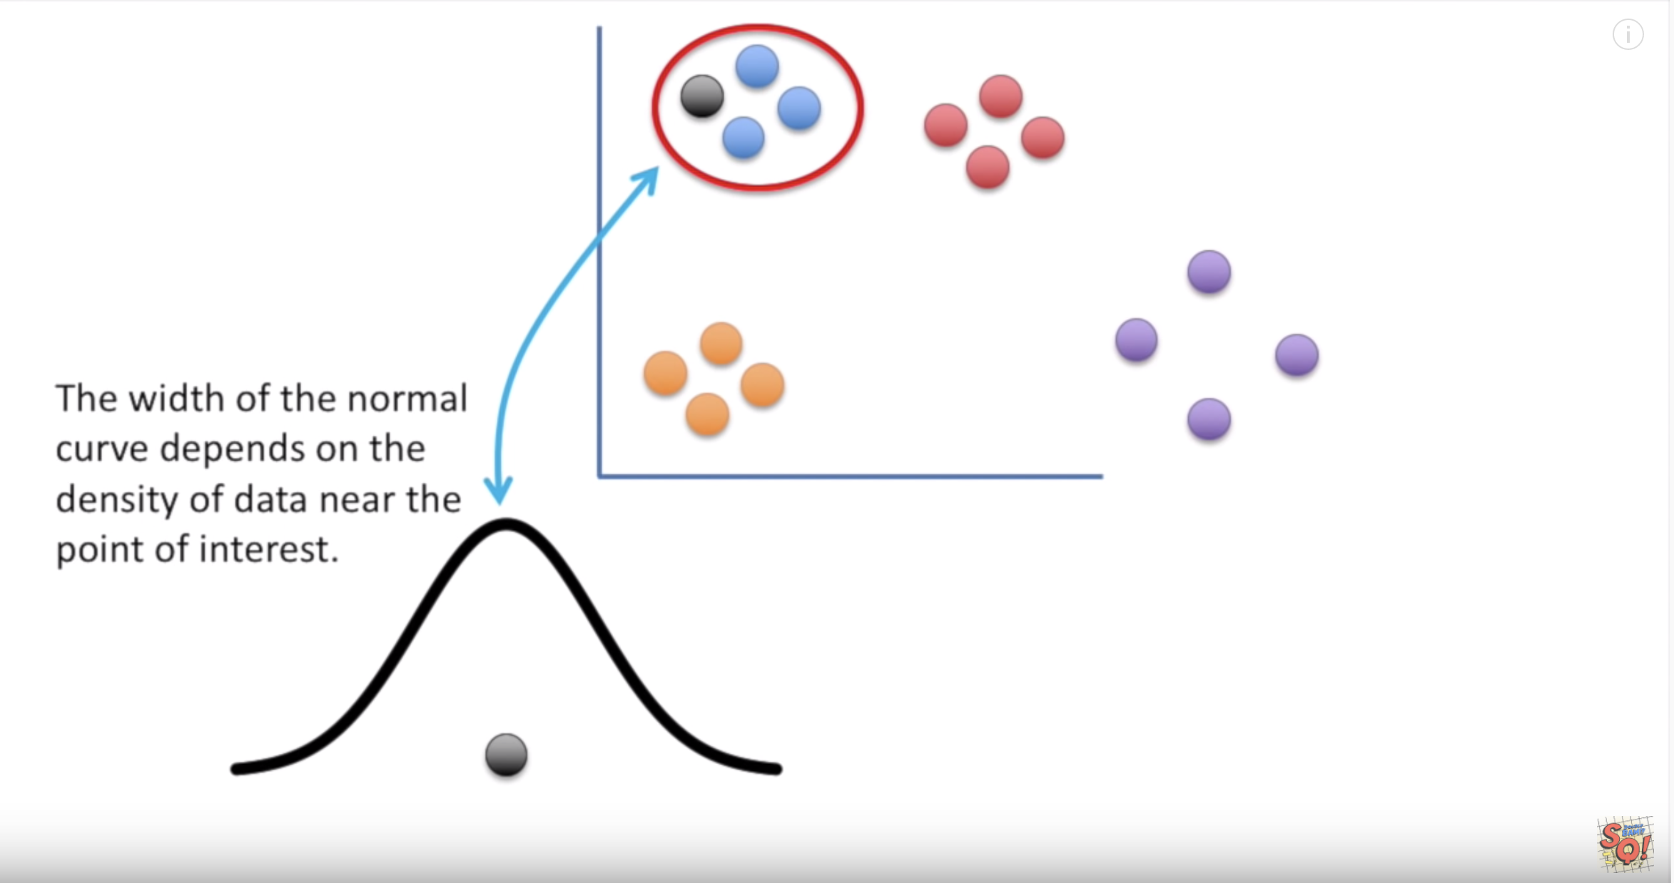
t-SNE
theory

Slide 41
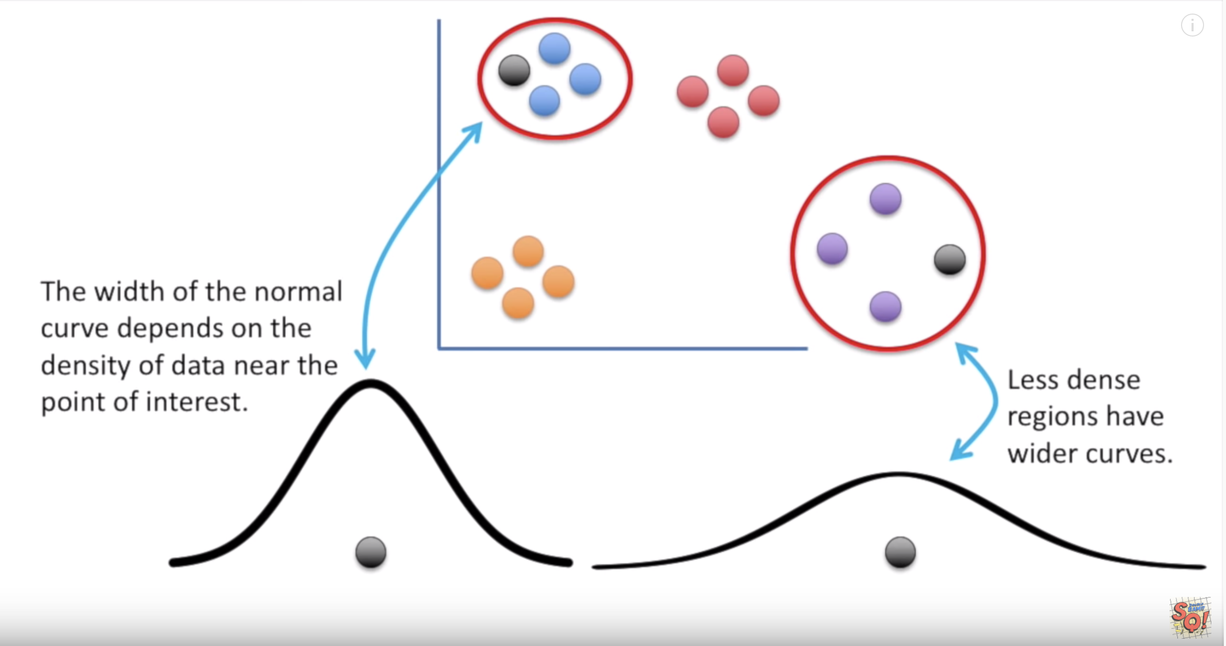
t-SNE
theory

Slide 42
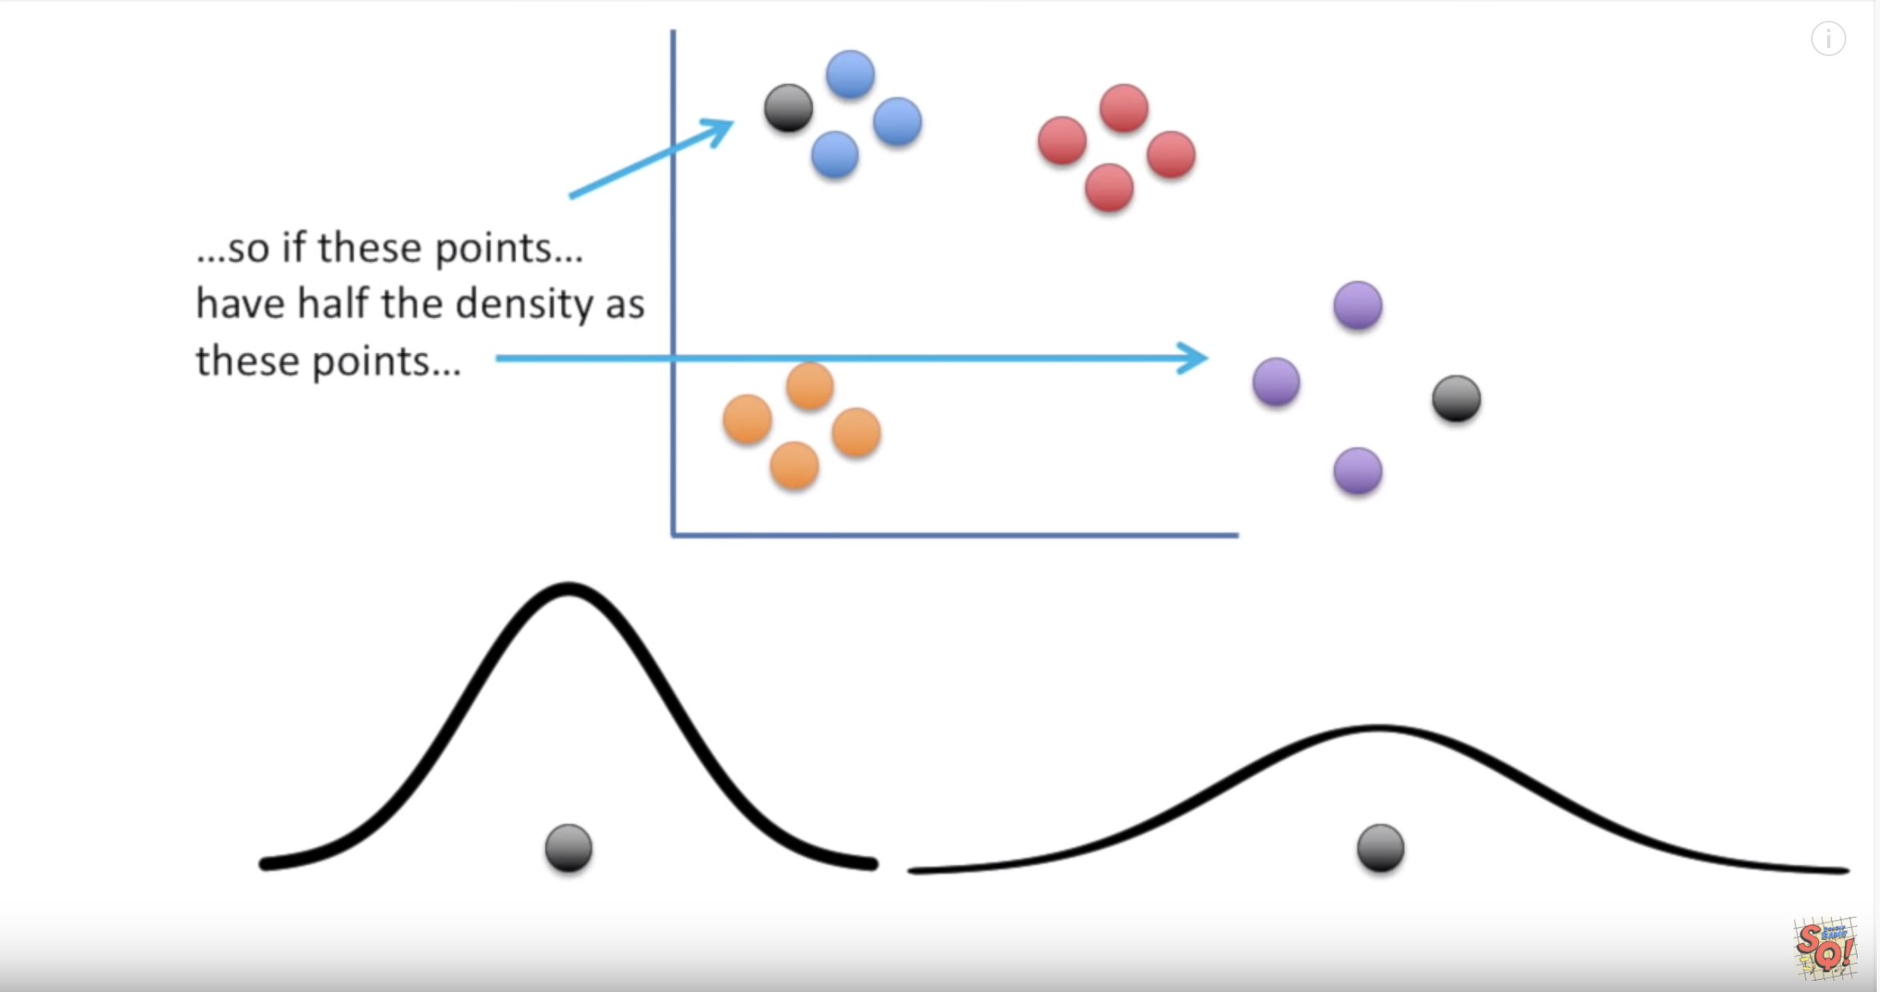
t-SNE
theory

Slide 43
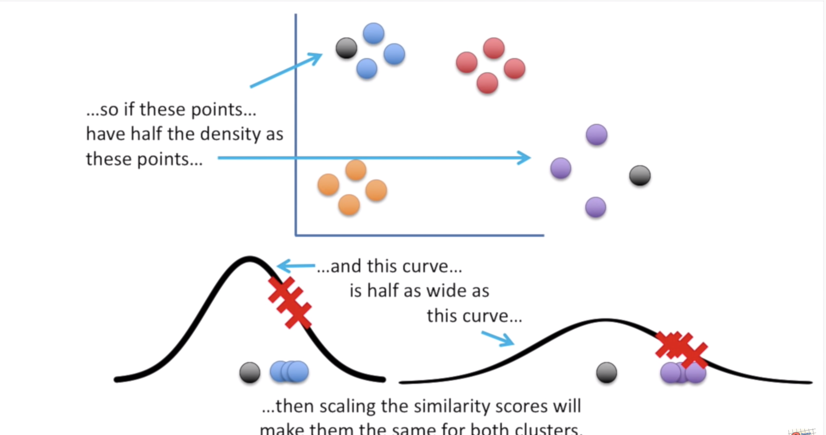
t-SNE
theory

Slide 44
t-SNE
theory

Slide 45
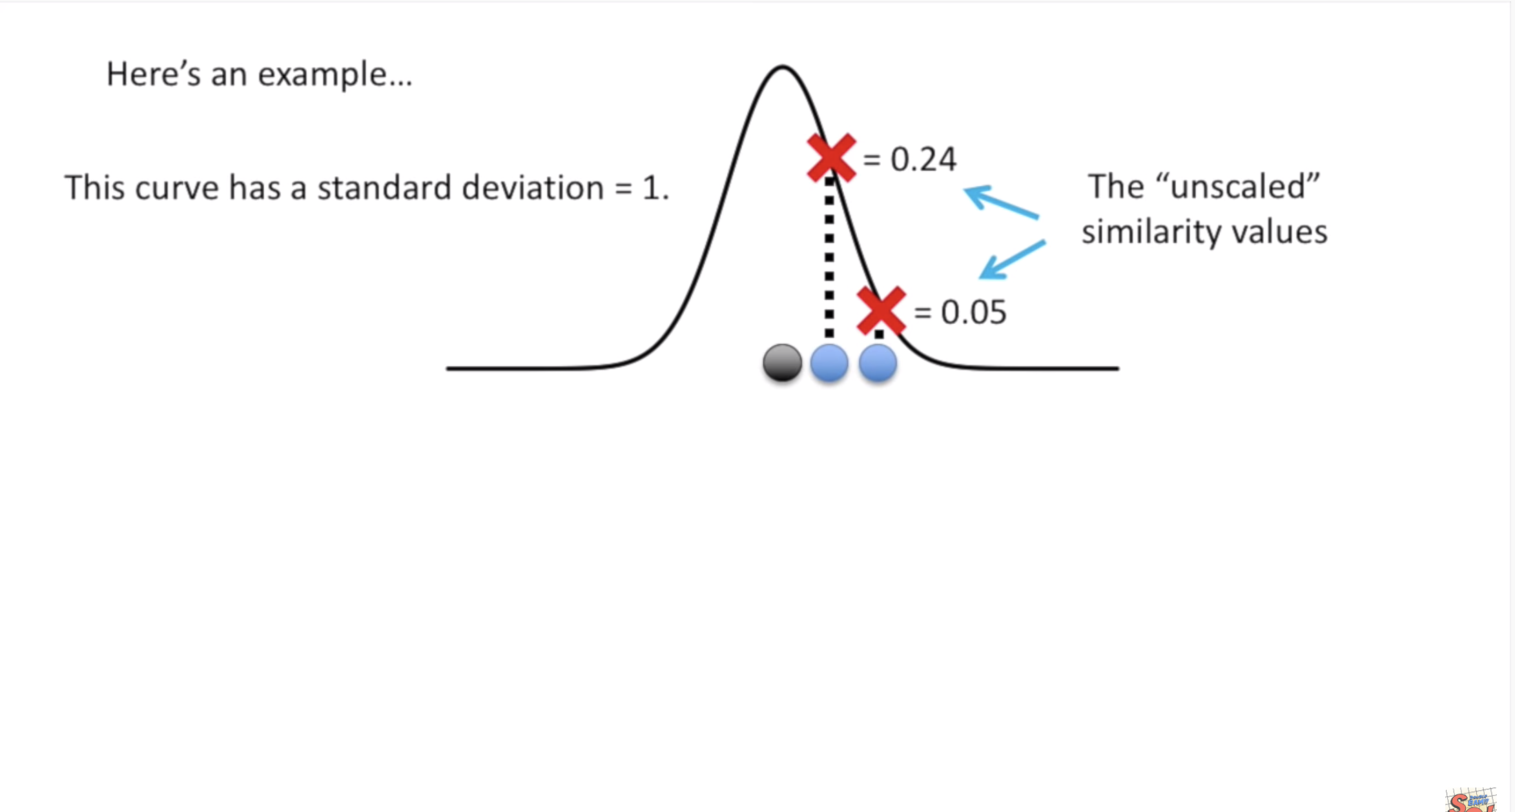
t-SNE
theory

Slide 46
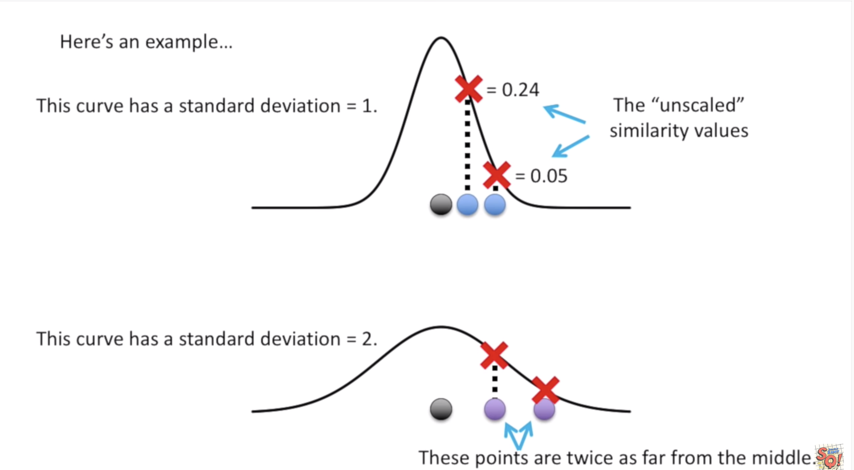
t-SNE
theory

Slide 47
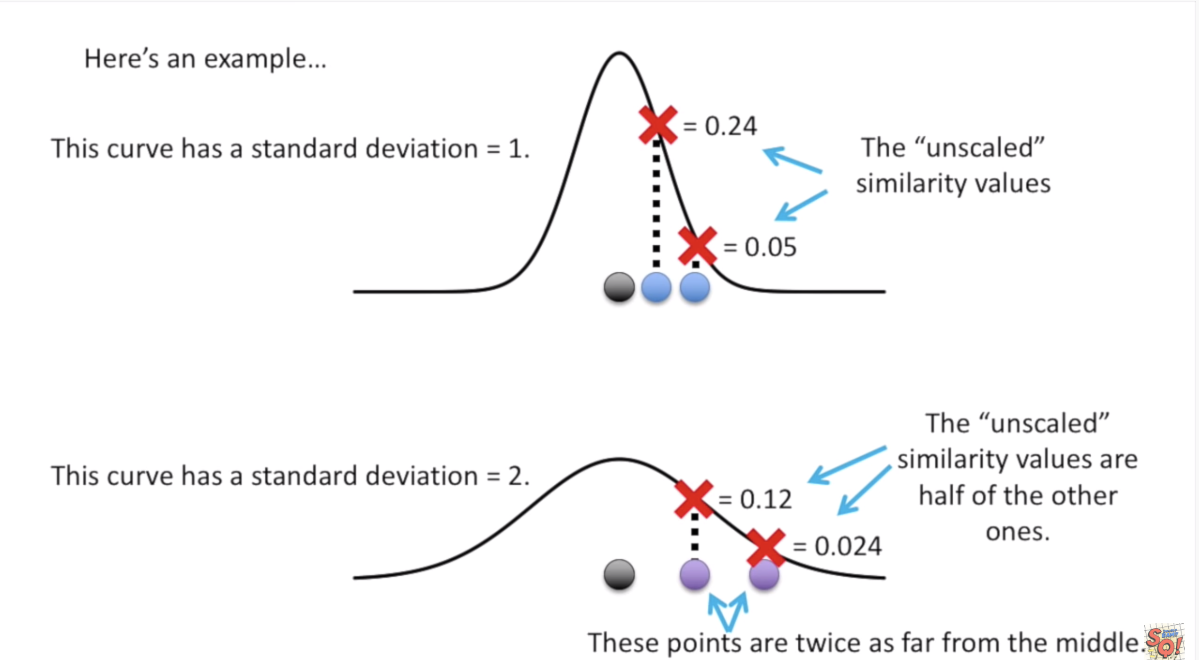
t-SNE
theory

Slide 48
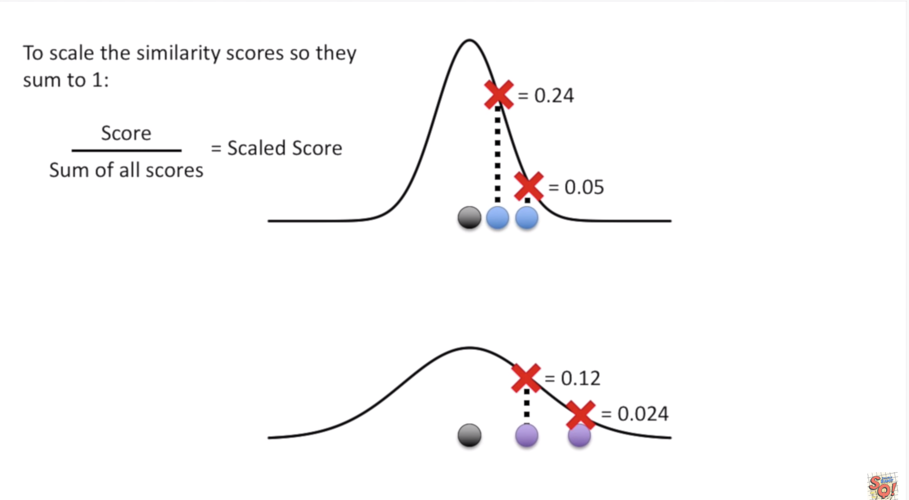
t-SNE
theory

Slide 49
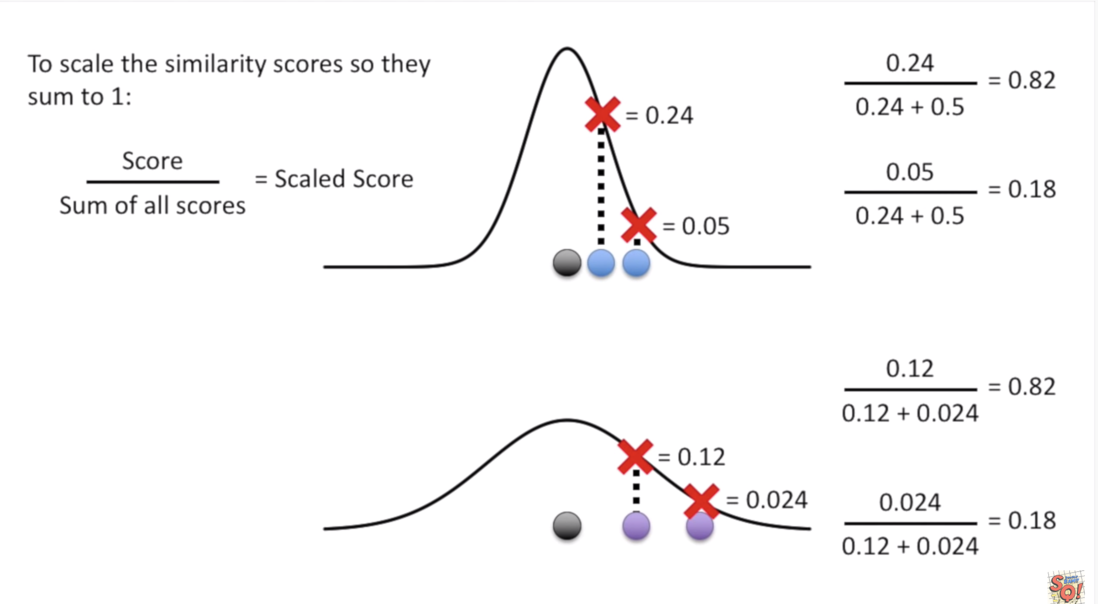
t-SNE
theory

Slide 50
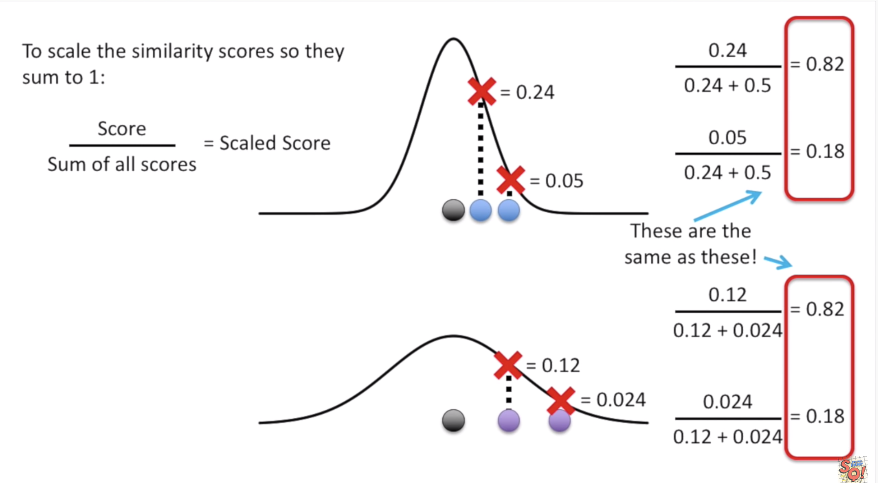
t-SNE
theory

Slide 51
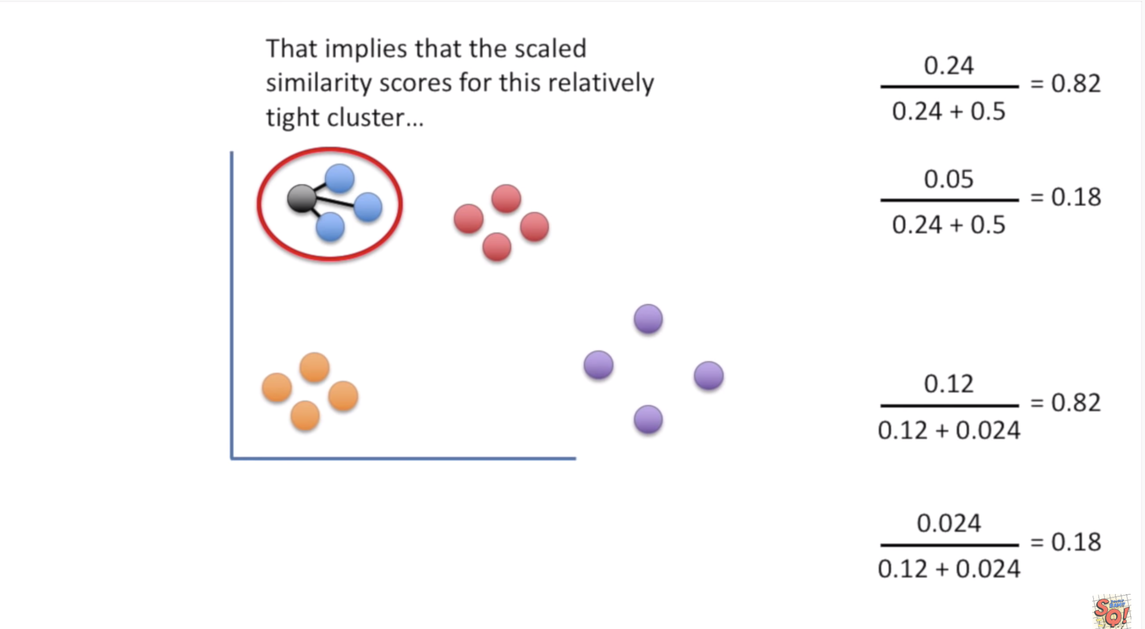
t-SNE
theory

Slide 52
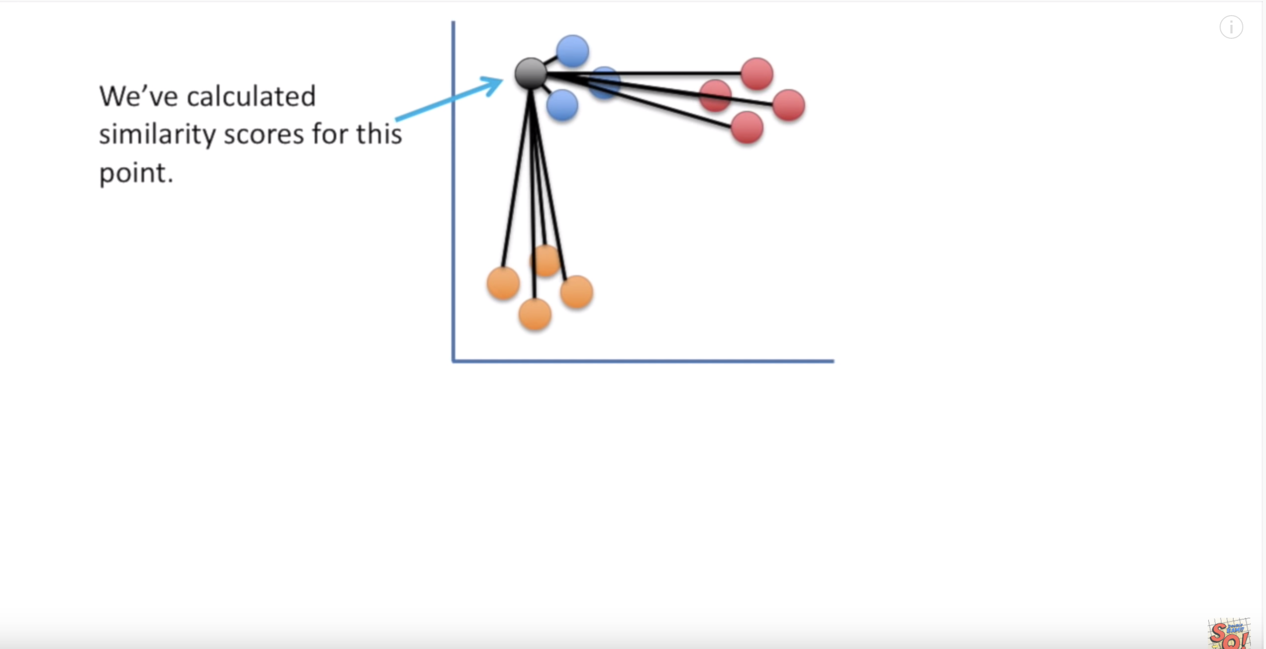
t-SNE
theory

Slide 53
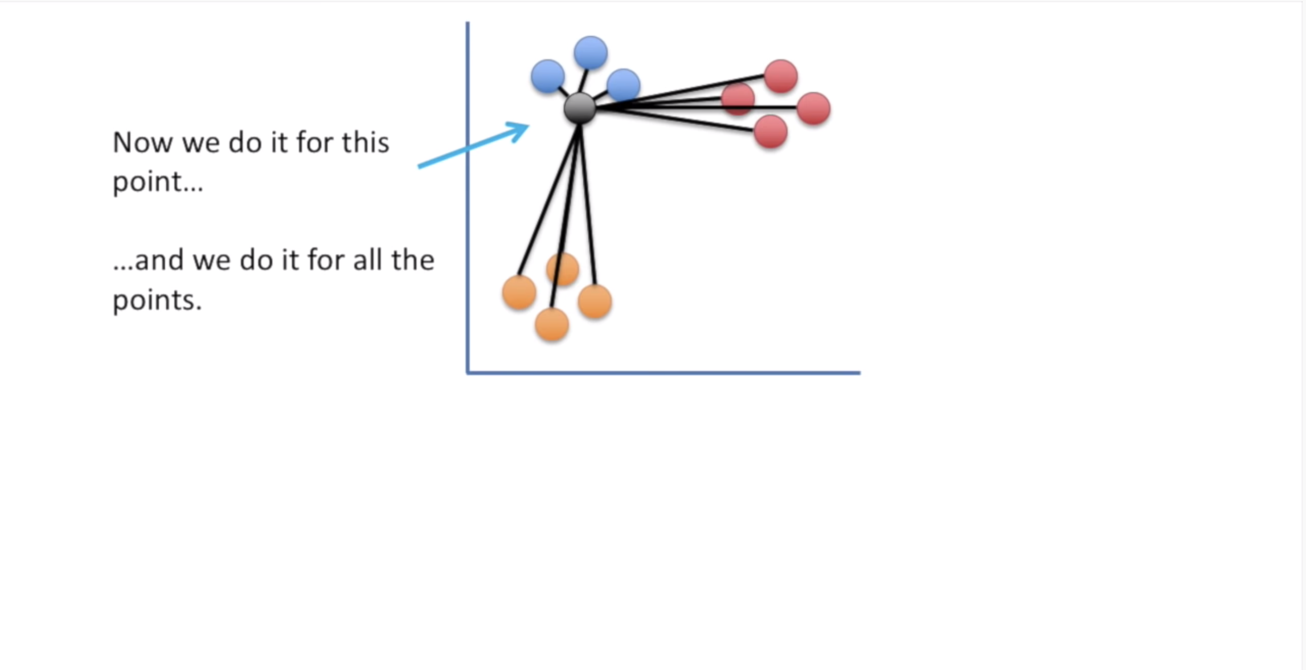
t-SNE
theory

Slide 54
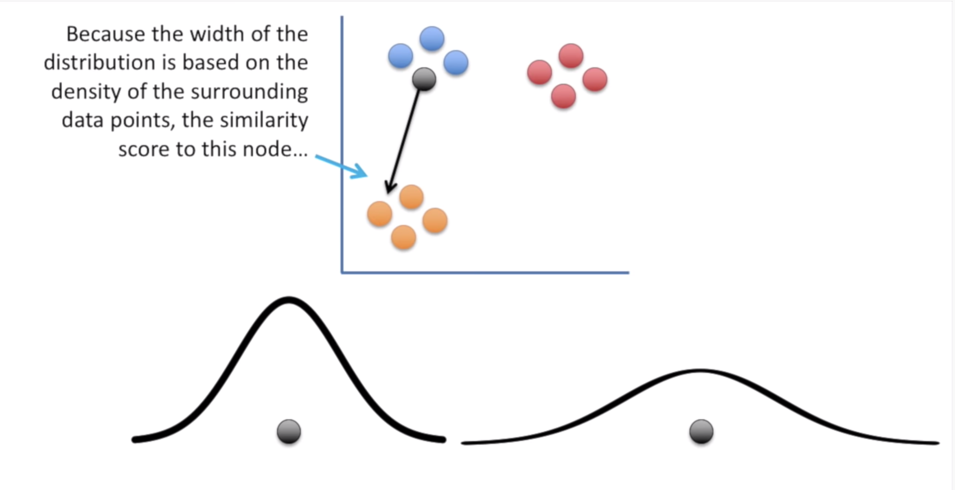
t-SNE
theory

Slide 55
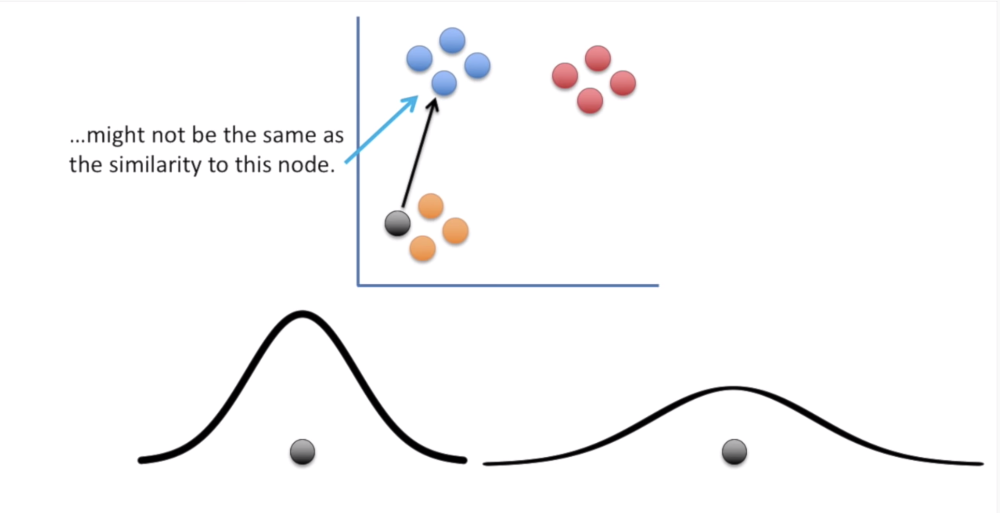
t-SNE
theory

Slide 56
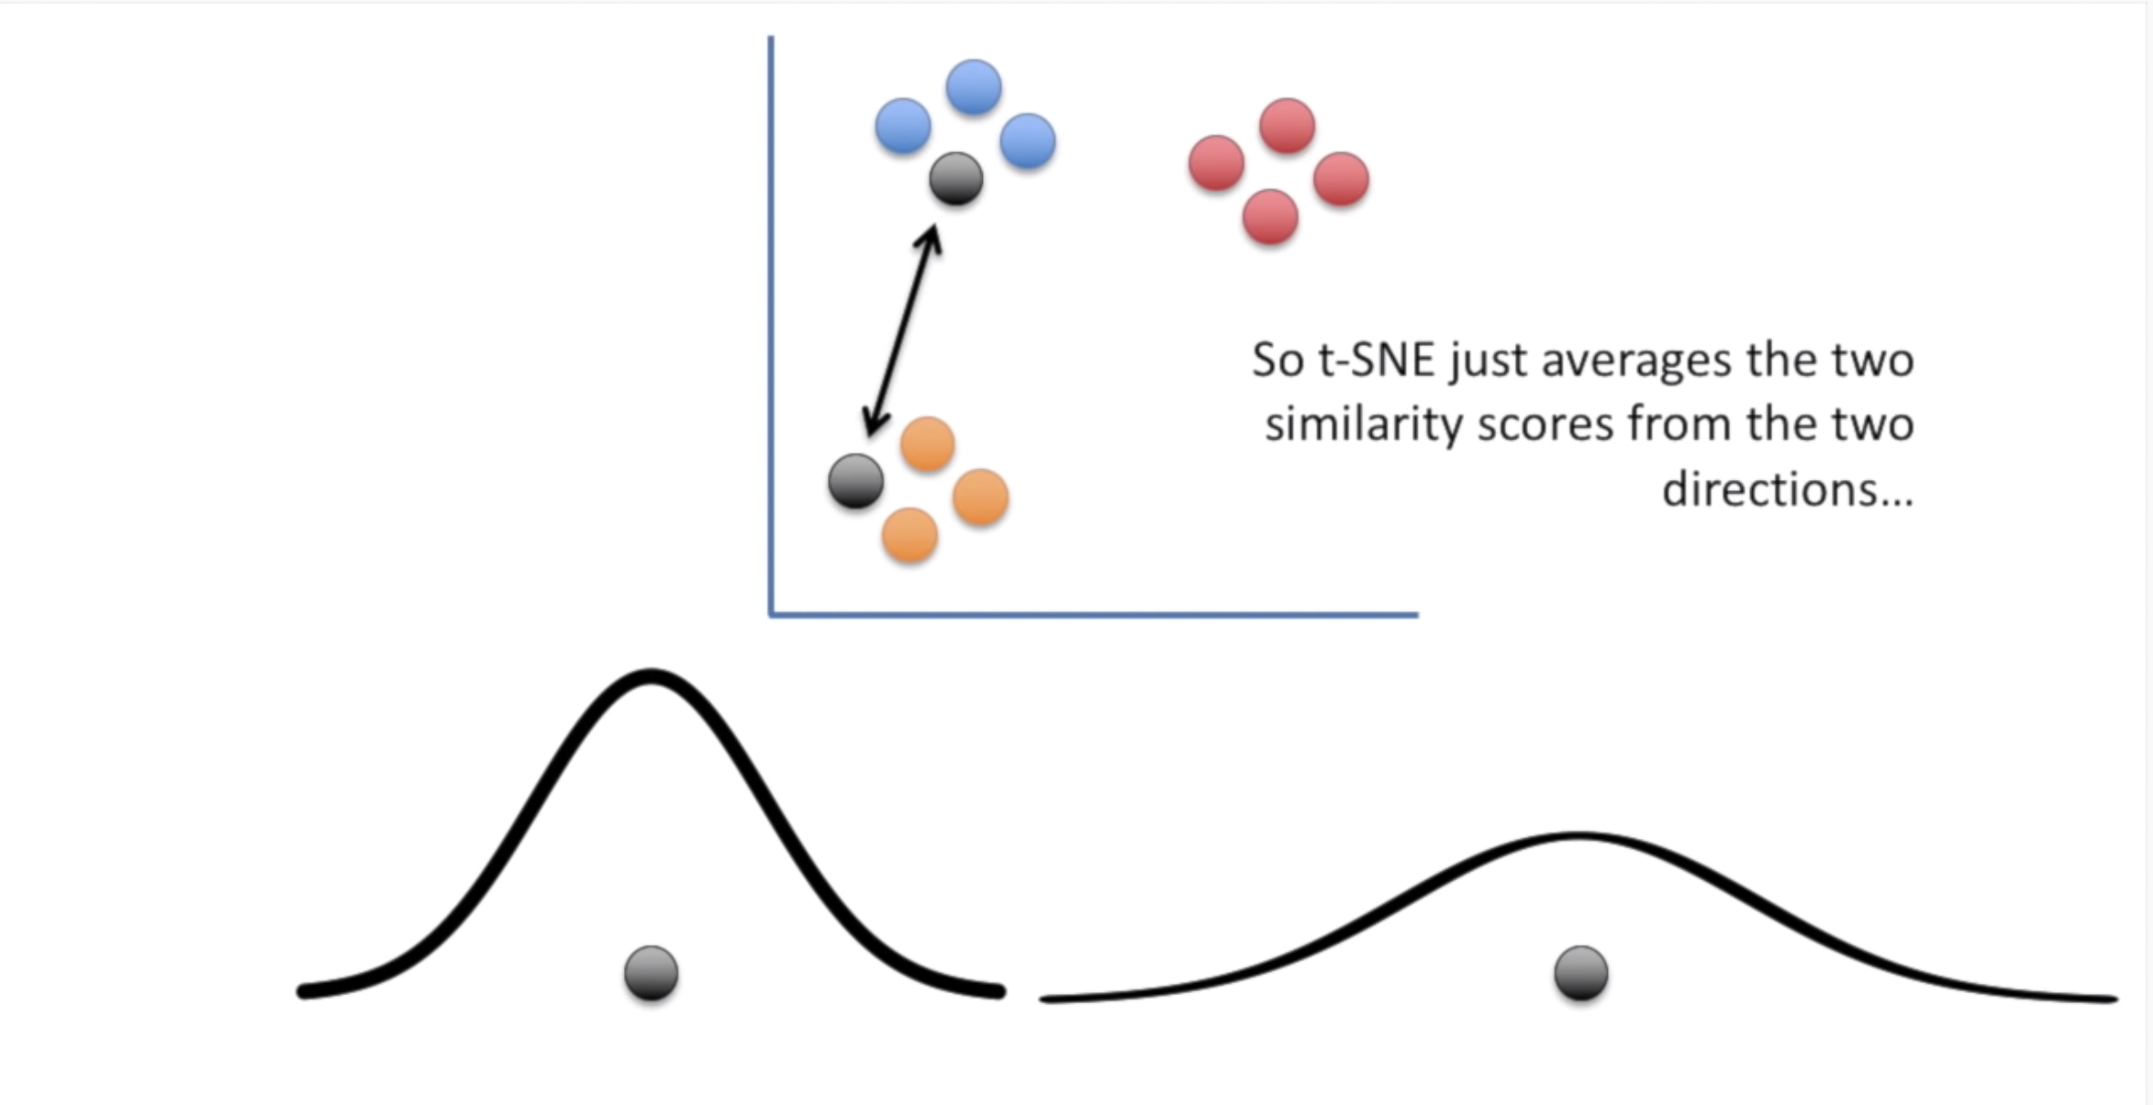
t-SNE
theory

Slide 57
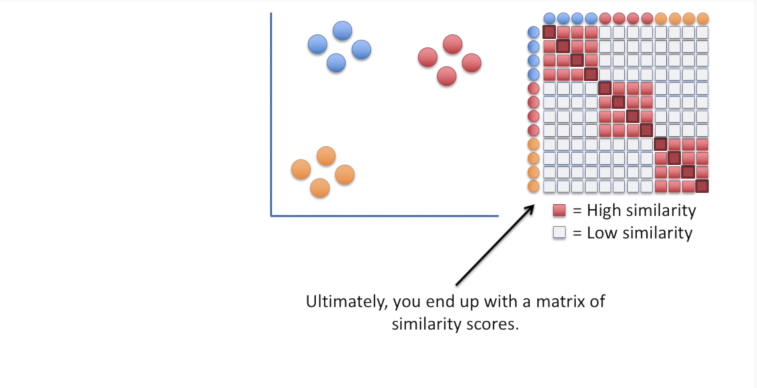
t-SNE
theory

Slide 58

t-SNE
theory

Slide 59

t-SNE
theory

Slide 60

t-SNE
theory

Slide 61

t-SNE
theory

Slide 62

t-SNE
theory

Slide 63

t-SNE
theory

Slide 64

t-SNE
theory

Slide 65

t-SNE
theory

Slide 66

t-SNE
theory

Slide 67

t-SNE
theory

Slide 68

t-SNE
theory

Slide 69

t-SNE
theory

Slide 70

t-SNE
theory

Slide 71

t-SNE
theory

Slide 72

t-SNE
theory

Slide 73

t-SNE
theory

Slide 74

t-SNE
theory

Slide 75

t-SNE
theory

Slide 76

t-SNE
theory

Slide 77

t-SNE
theory

Slide 79
t-SNE
theory

Slide 80
t-SNE
theory

Slide 81

t-SNE
theory

Slide 82
t-SNE
theory

Slide 83
t-SNE
theory

Slide 84
pca
theory
where regression determines a line of best fit to a data set, factor analysis determines several orthogonal lines of best fit to the data set.
Orthogonal means “at right angles”.
Actually the lines are perpendicular to each other in n-dimensional space
n-Dimensional Space is the variable sample space
There are as many dimensions as there are variable, so in a dataset with 4 variables the sample space has 4 dimensions

Slide 85

pca
theory
here we have some data plotted along two features, x and y

Slide 86

pca
theory
here we have some data plotted along two features, x and y
we can add an orthogonal line
Now we can begin to understand the components!

Slide 87
pca
theory
Components are a linear transformation that choose a variable system for the dataset such that the greatest variance of the dataset comes to lie on the first axis

Slide 88

pca
theory
The second greatest variance on the second axis and so on..
this process allows us to reduce the number of variables used in a analysis.

Slide 89
pca
theory
note that components are uncorrelated since in the same space the are orthogonal to each other

Slide 90

pca
theory
we can continue this analysis into higher dimensions

Slide 91
pca
analogy
we can continue this analysis into higher dimensions

Slide 92
pca
theory
we can continue this analysis into higher dimensions

Slide 93

pca
analogy

Slide 94

pca
analogy

Slide 95

pca
analogy

Slide 96

pca
analogy

Slide 97
pca
analogy
we know the cells are different but we can not observe differences from the outside

Slide 98
pca
analogy
we know the cells are different but we can not observe differences from the outside
so we sequence the mRNA in each cell to identify which genes are active. This tell us what the cell is doing

Slide 99

pca
analogy
we know the cells are different but we can not observe differences from the outside
so we sequence the mRNA in each cell to identify which genes are active. This tell us what the cell is doing

Slide 100
pca
analogy
each column show how much each gene is transcribed in each cell

Slide 101
pca
analogy
each column show how much each gene is transcribed in each cell
let’s imagine there were only 2 cells

Slide 102

pca
analogy
gene 1 is highly transcribed in cell1 and lowly transcribed in cell2

Slide 103
pca
analogy
gene 9 is lowly transcribed in cell1 and highly transcribed in cell2

Slide 104
pca
analogy
cell1 and cell2 have a clear inverse correlations

Slide 105
pca
analogy
This may means that they are probably two different types of cells using different genes

Slide 106
pca
analogy

Slide 107


pca
analogy

Slide 108

pca
analogy

Slide 109

pca
analogy

Slide 110

pca
analogy

Slide 111

pca
analogy

Slide 112

pca
analogy

Slide 113
pca
analogy
a pca plot converts the correlation among all the cells (features) into 2-D graph
cells highly correlated forms clusters

Slide 114

pca
analogy

Slide 115

pca
analogy

Slide 116

pca
analogy

Slide 117
pca
analogy
we have to take in mind that the axes are ranked in order of importance
Difference between clusters among the first principal component (PC1) are morE important than differences among PC2

Slide 118

pca
practice

Slide 119


